Slide 1

145 Nobel Laureates support GMOs
Richard J. Roberts
NIBIO – August 19th 2019

Slide 2
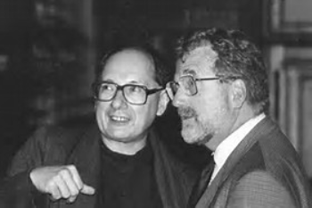

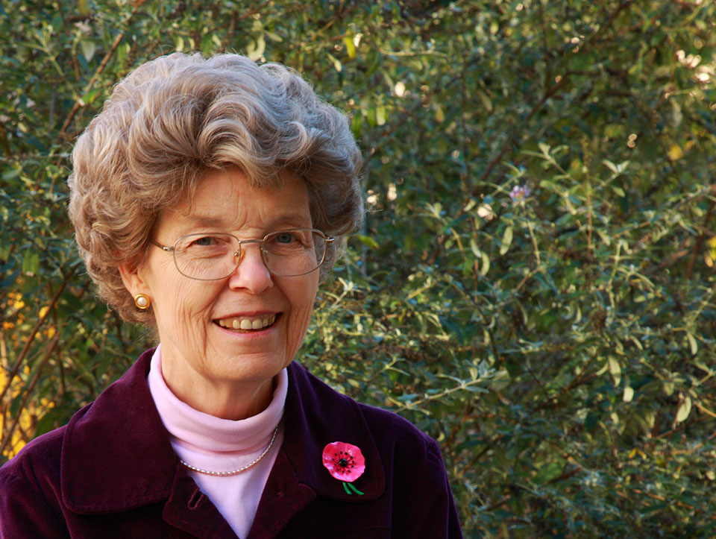
Marc Van Montagu and Jeff Schell
Discoverers of Ti plasmid transformation
together with Mary Dell Chilton

Slide 3
Remember that for the 800 million who go to bed hungry at night
FOOD is MEDICINE

Slide 4
Nobel Laureates call for science honesty about GMOs
Conceived in December, 2013
Planned during 2014-2015
Formal organization begun in July, 2015
Launched June 30th, 2016
We call on the Green parties to stop scaring the public by pretending that GMO foods must be banned because they are dangerous.

Slide 5
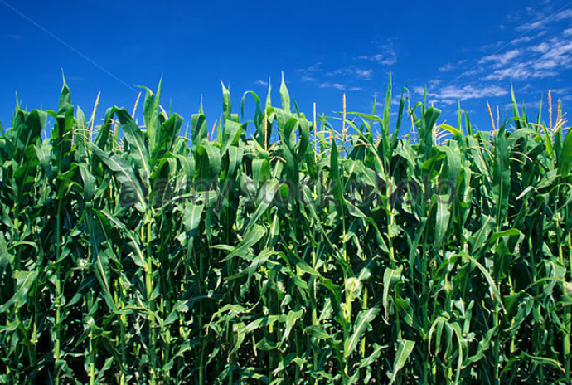
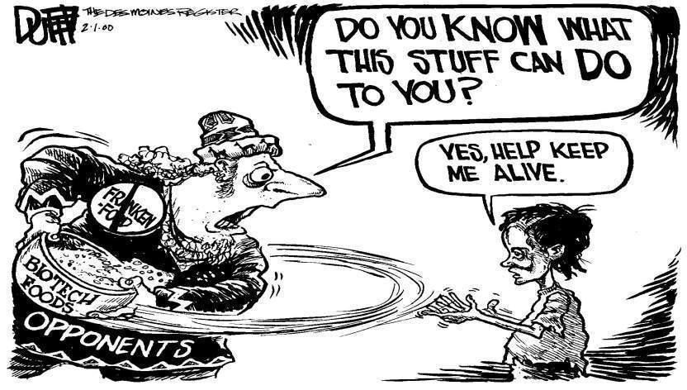
145 Nobel Laureates are urging everyone to acknowledge that GMO technology is basically safe and should be supported and encouraged for the sake of the developing world, who desperately need better yielding crops with added nutritional value.
https://supportprecisionagriculture.org/

Slide 6
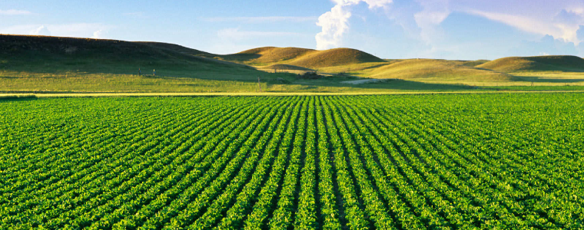
Food means Agriculture
For 10-12,000 years we had been using crude genetics
But in the 1980’s we learned how to be precise

Slide 7
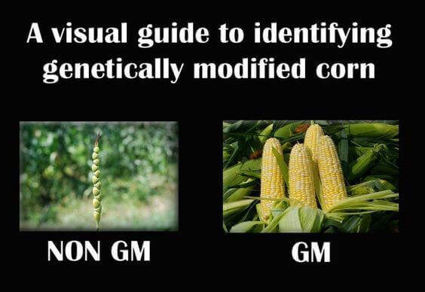
Teosinte
the wild ancestor
GM by Nature
Modern corn
In our supermarkets
GM by man

Slide 8
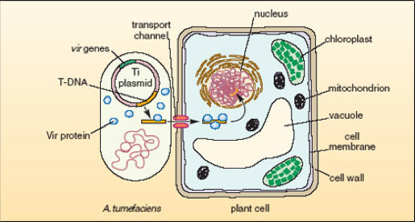
Natural Agrobacterium tumefaciens transformation

Slide 9
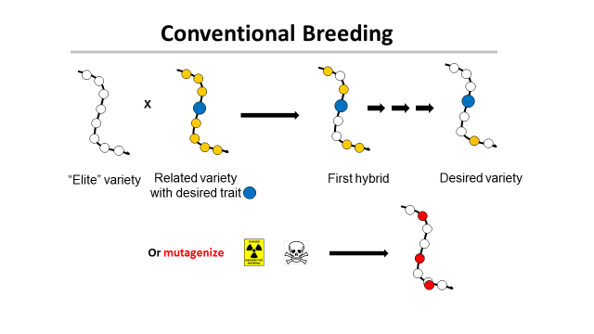
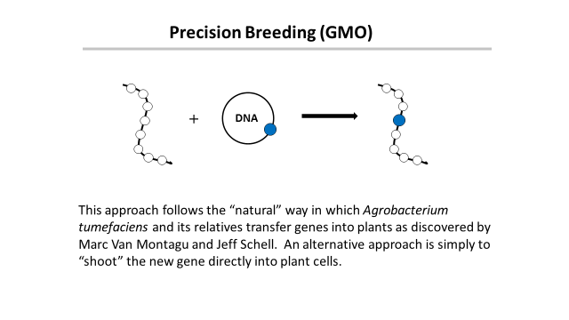
‘This is safe!’
← Greenpeace says →
‘This is dangerous!’

Slide 10
Traditional versus precision methods
I want to move a GPS system from my old car into my new one
Should I disassemble two cars, mix up the parts and then “select” for the one with the GPS, ignoring what else it might have picked up?
Or should I take the GPS from one car and move it to the other?

Slide 11

Traditional versus precision methods
If I take a GPS from an airplane
will the new car fly?

Slide 12
Genetic Modification refers to a method
But what is important is the
PRODUCT
not the
METHOD
This is just as true for traditional breeding

Slide 13
Plants can’t run away from predators
So how do they protect themselves?
With pesticides!

Slide 14
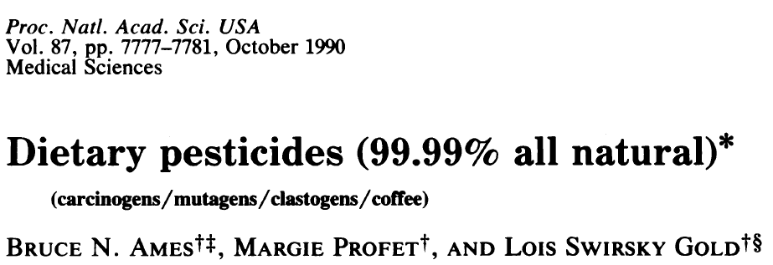
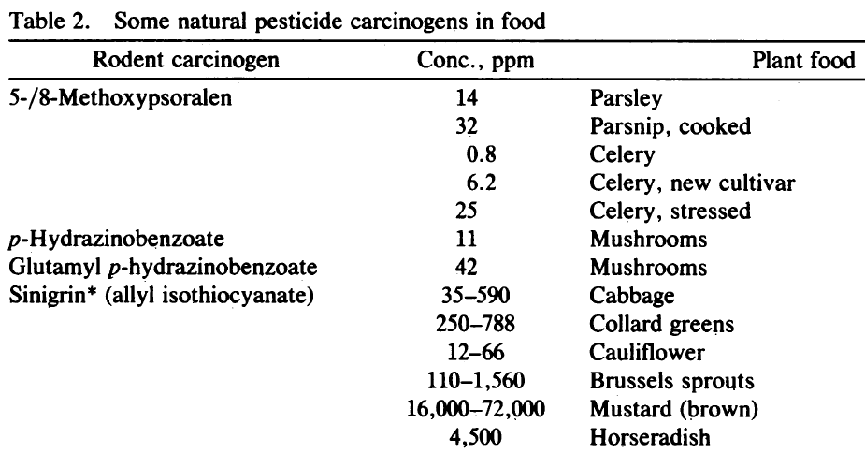
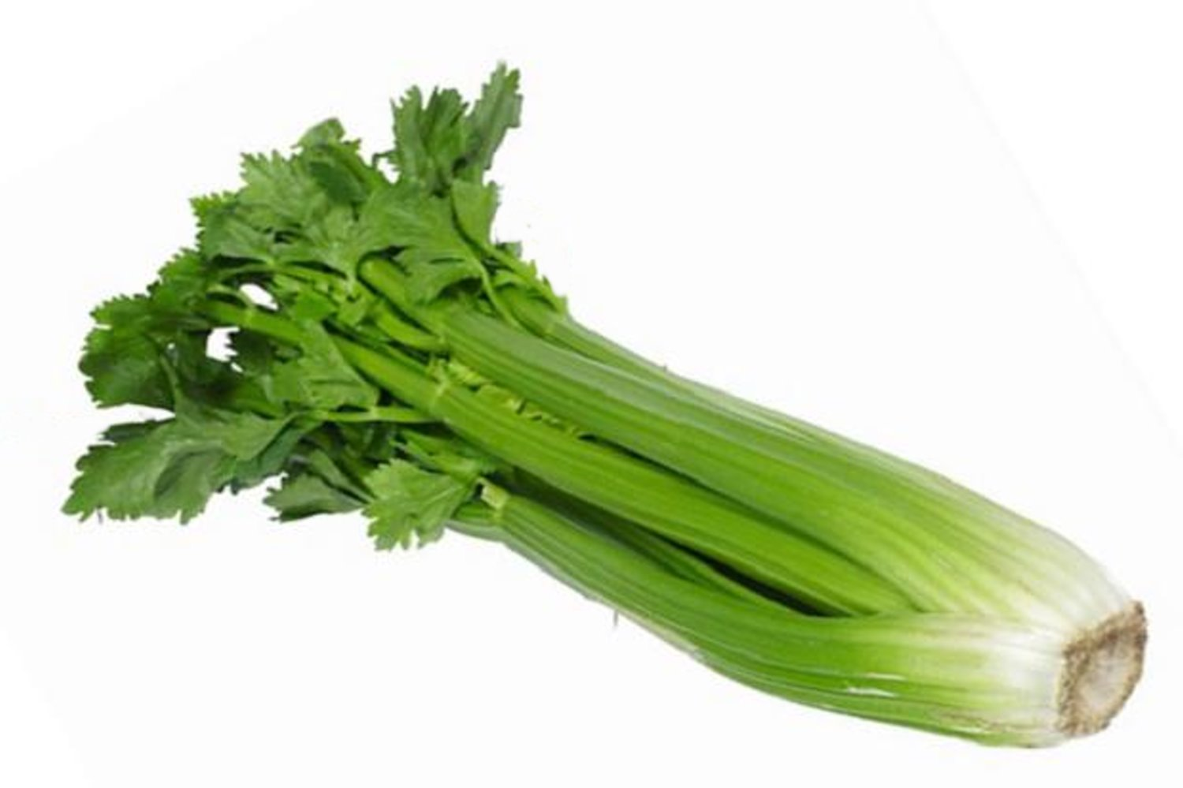
Many common vegetables have high levels of natural pesticides.
+ 11 more

Slide 15

Food in Developing Countries
Africa, S. America, Asia need better crops with higher yields.
They need the products of precision breeding
Europe doesn’t – YET!
So why doesn’t Europe endorse this?
Could it be politics, or money or both?

Slide 16
The Real Problem
Europeans did not want US companies to control their food
How can that be prevented?
Ban Monsanto and the other big US agribusinesses
Not so fast - the farmers buy their seeds from them

Slide 17
The Green Parties Solution
Assert that precision breeding might be dangerous!
The politicians and the green parties will protect
you from this risk by banning growing GMOs
Best of all
This has no economic consequence for Europe !

Slide 18
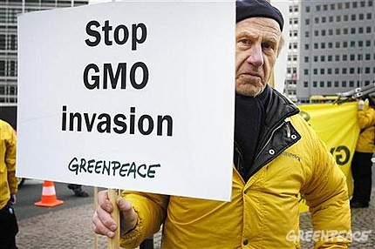
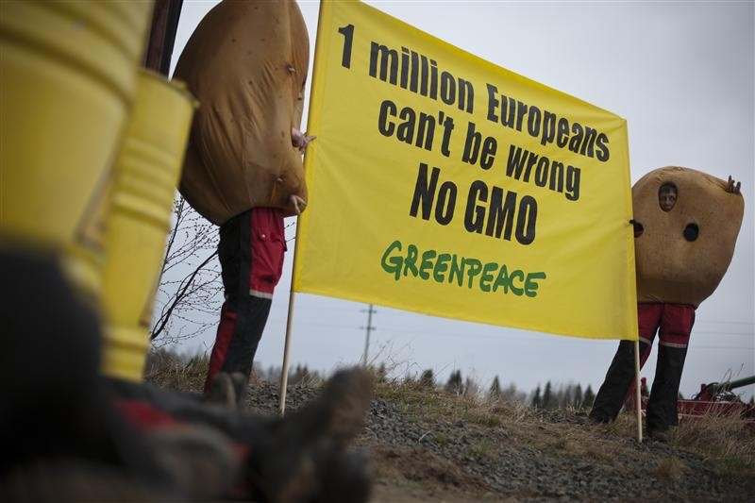

The tragic consequences
Not content with blocking precision agriculture in Europe many politicians and NGOs like “Greenpeace” and “Friends of the Earth” are now spreading their message to the developing countries

Slide 19
A case study
Vitamin A-deficiency
Global population mortality (in millions)
Vitamin A-deficiency | 1.9-2.7
HIV/Aids | 1.7
Tuberculosis | 1.4
Malaria | 0.75
*Courtesy of Ingo Potrykus
Notes:
Golden Rice and Beyond – challenges of a humanitarian GMO project.

Slide 20
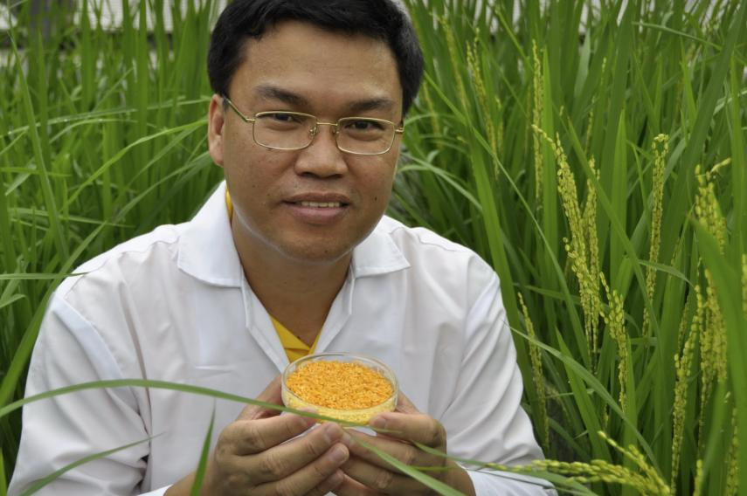
Golden Rice
A new source of Vitamin A
Ingo Potrykus, ETH Zurich
Peter Beyer, U. Freiburg
Introduce the genes for
β-carotene into rice
Courtesy of Ingo Potrykus

Slide 21
Golden Rice
Became a reality in February, 1999.
Could have been in the field within 2-5 years, beginning to save children from blindness and death.
But it’s a GMO and only now will it soon be available in Bangladesh.
Why?
Multiple years of delay due to regulation and opposition.
Courtesy of Ingo Potrykus
Notes:
Golden Rice and Beyond – challenges of a humanitarian GMO project.

Slide 22

Science Fiction
Greenpeace blocks development
And then claims
It has taken so long it can’t possibly work

Slide 23
Since 2002 as many as 15 million children have died or suffered because of Vitamin A deficiency
How many must die before we consider this a “crime against humanity” that should be prosecuted?

Slide 24
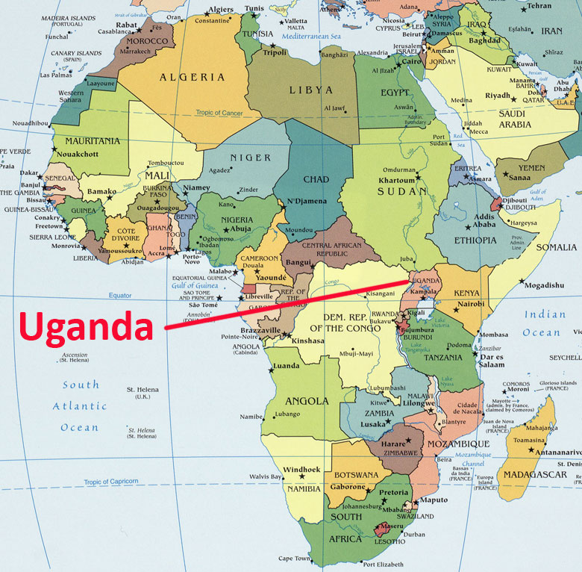
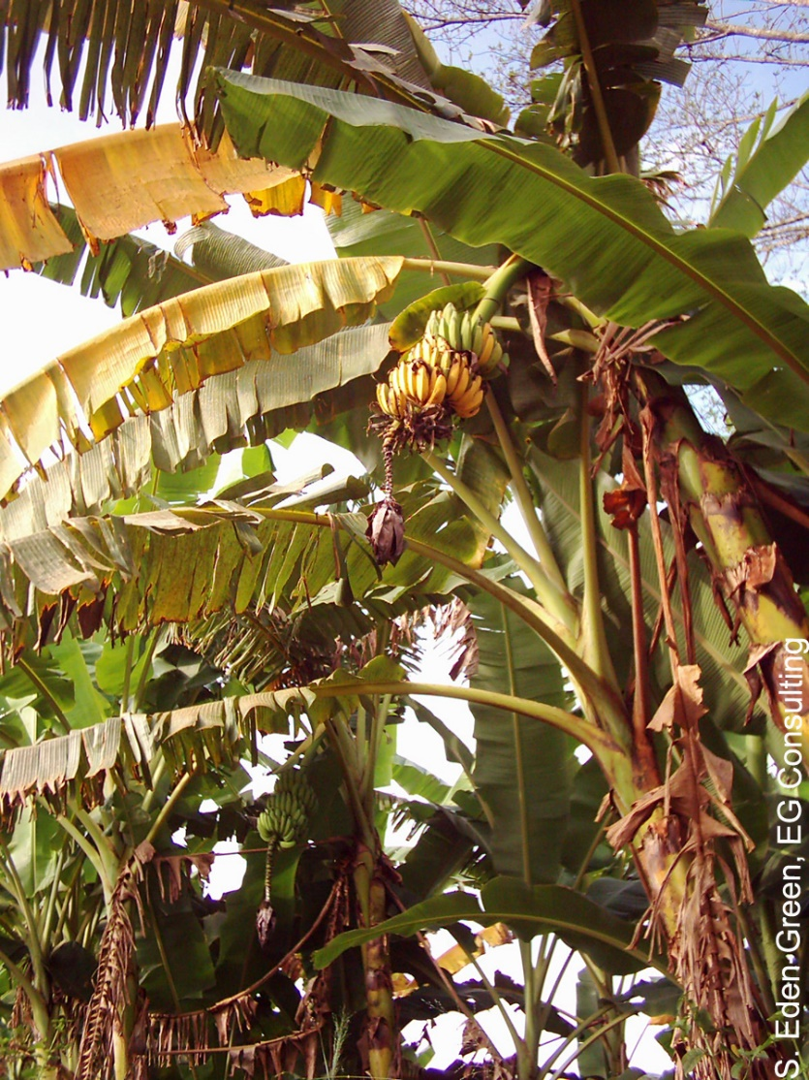
The Banana Problem
Xanthomonas wilt
No natural varieties are resistant so no
traditional breeding solution
BUT
Sweet pepper is resistant to Xanthomonas campestris and two genes are known that mediate this resistance. Using precision techniques these genes have been transferred to banana and these modified bananas are now beginning field trials.

Slide 25


Slide 26
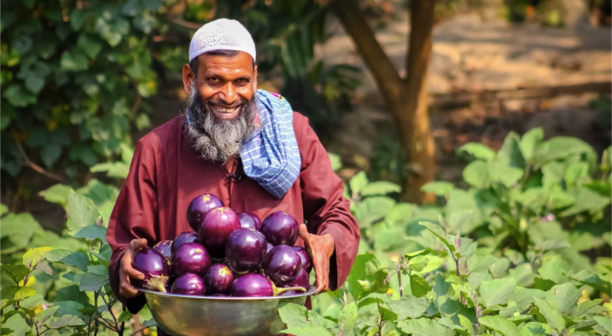
Bangladesh: Bt eggplant
Slide courtesy of Arif Hossain/Cornell Alliance for Science

Slide 27
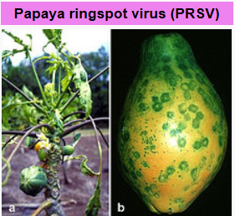

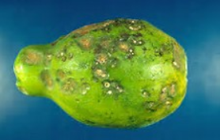
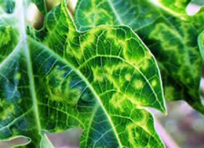
Hawaiian papayas
Almost a disaster

Slide 28
GMO Papaya saves the Hawaiian crop
In the 1990s, Hawaiian papaya trees were plagued by the ringspot virus which decimated half the crop in the state.
In 1998, Dennis Gonsalves from the University of Hawaii developed a transgenic fruit called Rainbow papaya, which is resistant to the virus.
Now 77 percent of the crop grown in Hawaii is genetically engineered and being eaten in the USA.
But in Thailand this solution is banned

Slide 29
Food choice is a luxury of the developed world
If you don’t want to eat foods derived by GM techniques, then don’t. It’s your choice
But don’t pretend such foods are dangerous
But remember if anything
They are probably safer than traditional foods

Slide 30
Science Facts
For developed countries food is not a problem.
We must never forget the consequences of our actions for the developing countries
We need more science in politics
And less politics in science

Slide 31
Actions needed around the world
Politicians should listen to the scientists they fund
Stop supporting the idea that foods produced by precision breeding methods must be inherently more dangerous than traditional methods, when science shows they are not

Slide 32
Civil Society must play its role too
The major religious leaders should speak out
Groups such as the Rotary Clubs should speak out
Influential celebrities should speak out
The media should present science facts not science fiction

Slide 33
CONGREGATION FOR DIVINE WORSHIP
AND THE DISCIPLINE OF THE SACRAMENTS
Prot. N. 320/17
Circular letter to Bishops
on the bread and wine for the Eucharist
.
.
.
.
5. The same Congregation also decided that Eucharistic matter made with genetically modified organisms can be considered valid matter (cf. Letter to the Prefect of the Congregation for Divine Worship and the Discipline of the Sacraments, 9 December 2013, Prot. N. 89/78 – 44897).

Slide 34

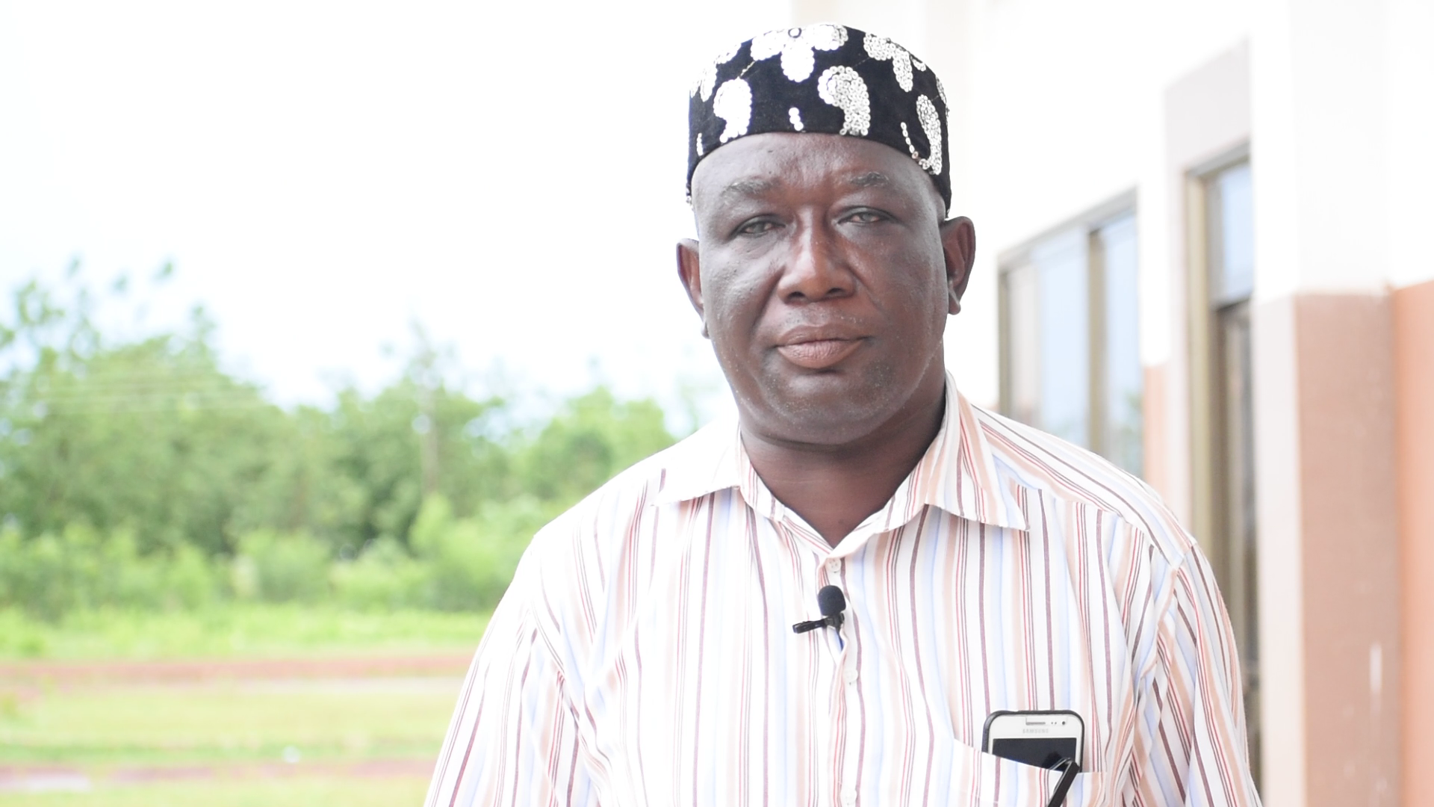
News from Ghana: The former leader of the Peasant Farmers’ Association, Ghana’s primary anti-GMO farmers group, has switched sides to adopt a pro-GMO position.
Mohammed Adams Nasiru attributed his shift to receiving accurate information on agricultural biotechnology from the scientific community.

Slide 35

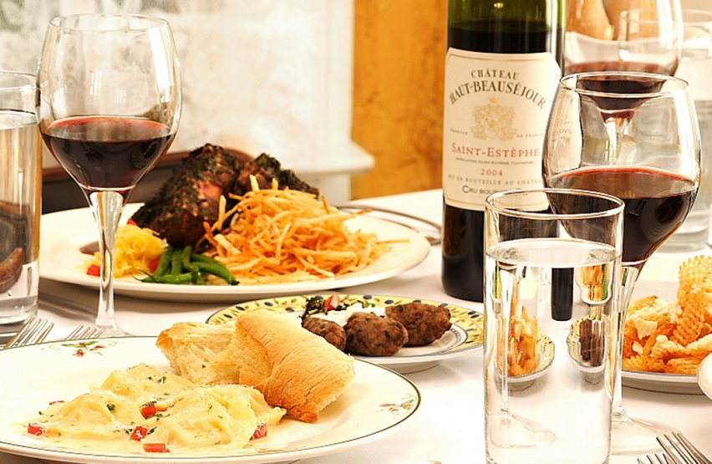
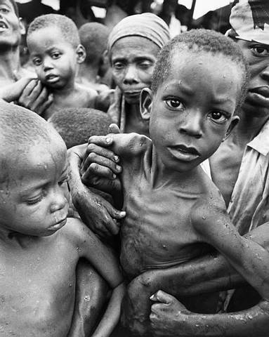
Have a heart
Non-GMO is a Western indulgence of the rich
It doesn’t work for the poor in Africa
https://supportprecisionagriculture.org/

