Slide 1
133 Nobel Laureates love GMOs
Join the Nobel Laureate campaign
to support GMOs
http://supportprecisionagriculture.org/
Lindau – June 26th 2018

Slide 2
Remember that for the 800 million who go to bed hungry at night
FOOD is MEDICINE

Slide 3
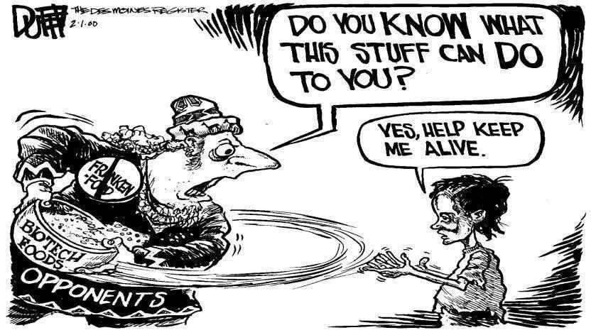
133 Nobel Laureates have written an open letter to Greenpeace and every UN Ambassador urging an acknowledgment that GMO technology is basically safe and should be supported for the sake of the developing world, who desperately need better yielding crops with added nutritional value.
http://supportprecisionagriculture.org/

Slide 4
Food means Agriculture
For 10-12,000 years we had been using crude genetics
But in the 1980’s we learned how to be precise

Slide 5
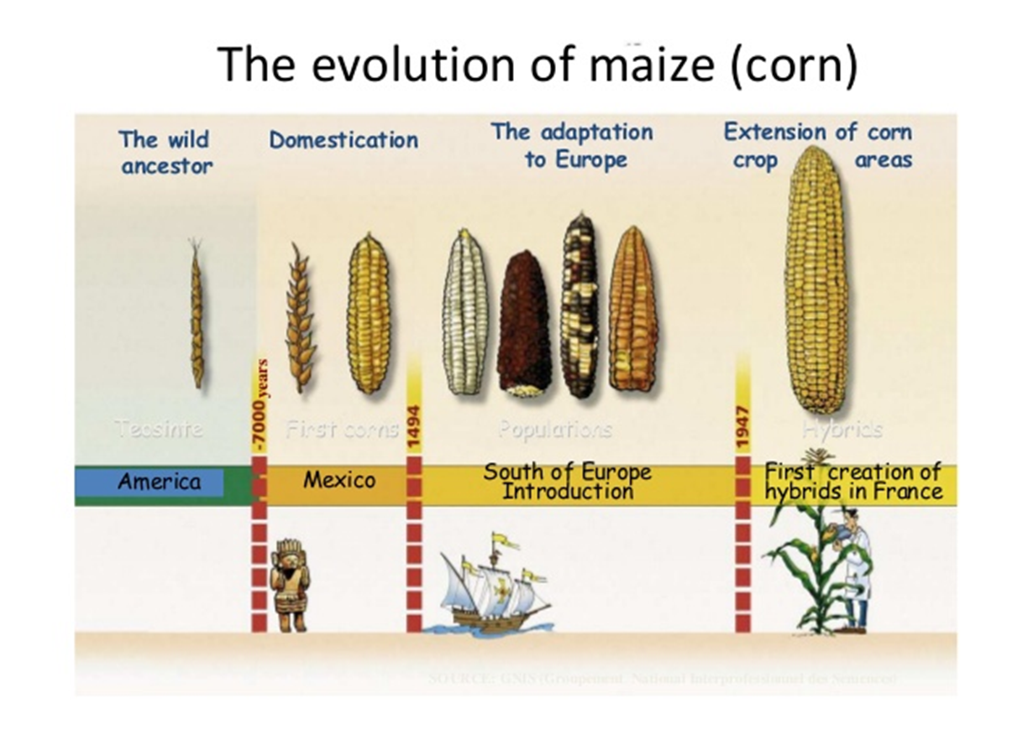

Slide 6
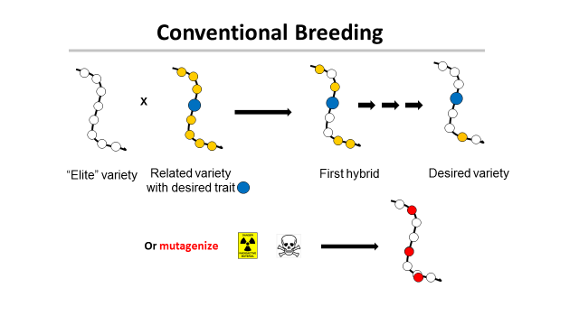
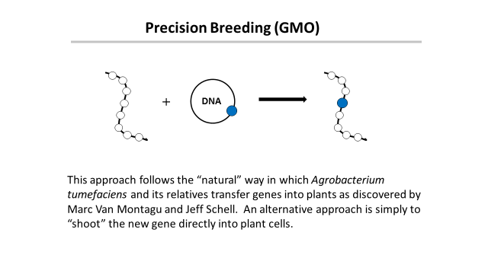
‘This is safe!’
← Greenpeace says →
‘This is dangerous!’

Slide 7
Traditional versus precision methods
I want to move a GPS system from my old car into my new one
Should I disassemble two cars, mix up the parts and then “select” for the one with the GPS, ignoring what else it might have picked up?
Or should I take the GPS from one car and move it to the other?

Slide 8
Traditional versus precision methods
If I take a GPS from an airplane
will the new car fly?

Slide 9
GMO refers to a method
But what is important is the
PRODUCT
not the
METHOD
This is just as true for traditional breeding

Slide 10
Plants can’t run away from predators
So how do they protect themselves?
With pesticides!

Slide 11
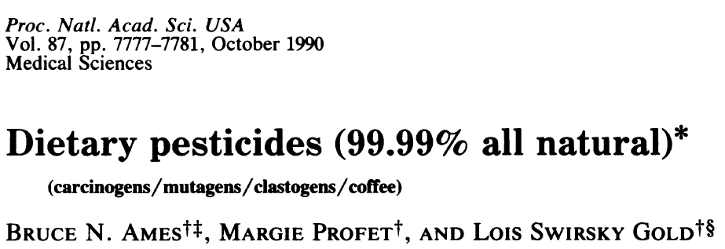
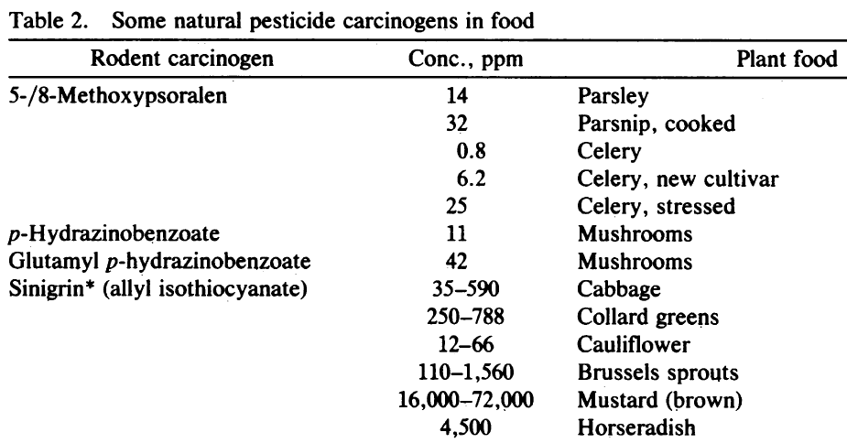
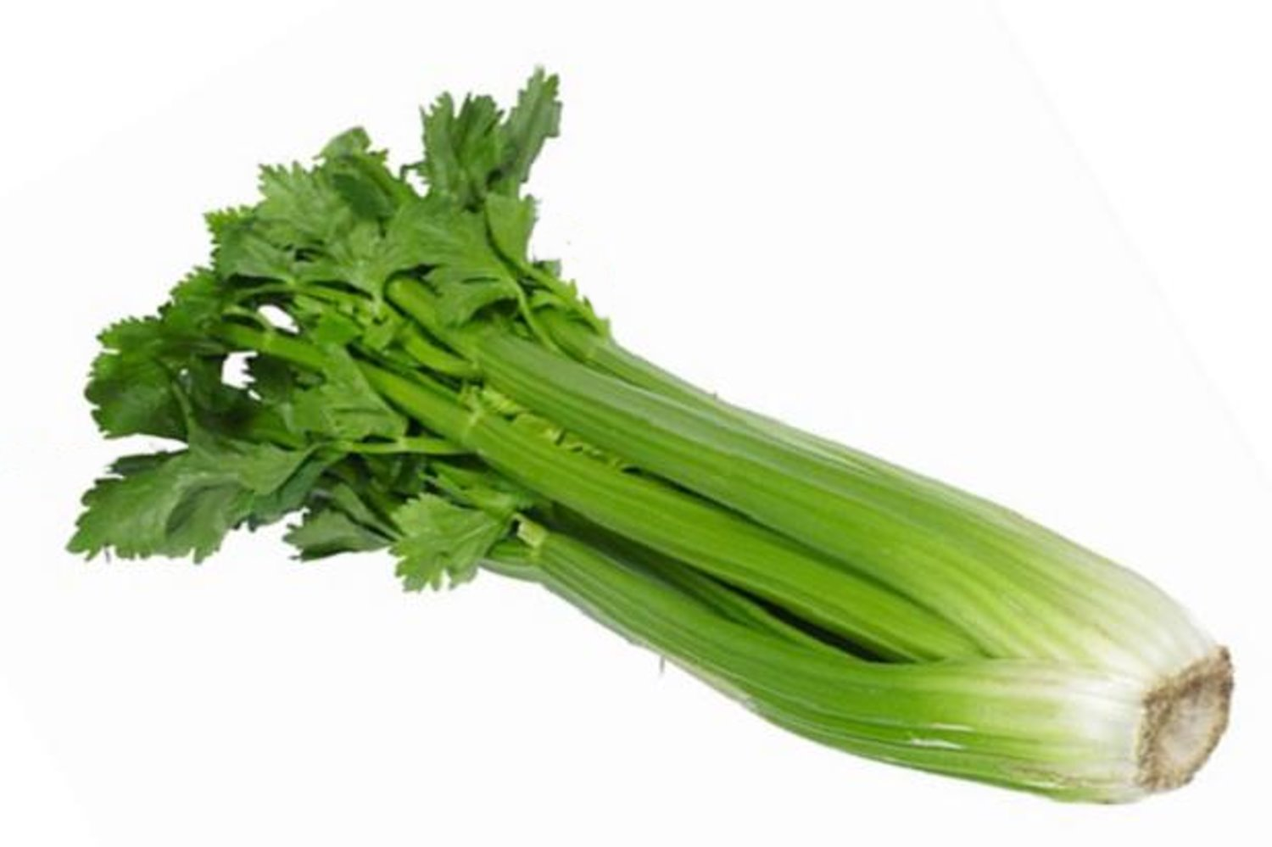
Many common vegetables have high levels of natural pesticides.
+ 11 more

Slide 12
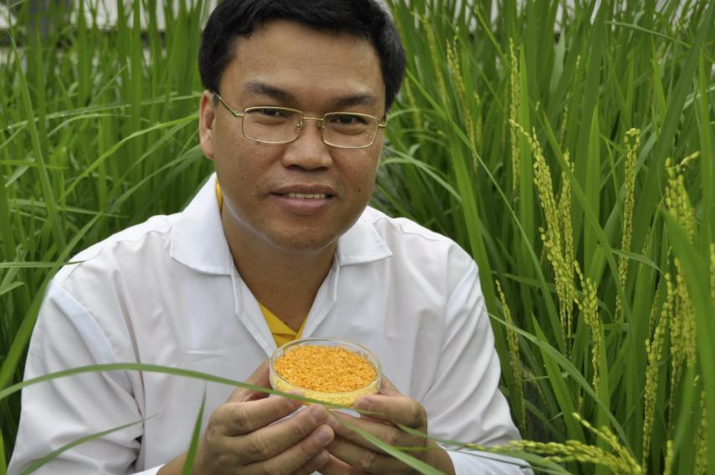
Golden Rice
A new source of Vitamin A
Ingo Potrykus, ETH Zurich
Peter Beyer, U. Freiburg
Courtesy of Ingo Potrykus

Slide 13
Golden Rice
Became a reality in February, 1999.
Could have been in the field within 2-5 years, beginning to save children from blindness and death.
But it’s a GMO and will only be available later this year.
Why?
Multiple years of delay due to regulation and opposition.
Courtesy of Ingo Potrykus
Notes:
Golden Rice and Beyond – challenges of a humanitarian GMO project.

Slide 14
Science Fiction
Greenpeace blocks development
And then claims
It has taken so long it can’t possibly work

Slide 15
Since 2002 as many as 15 million children have died or suffered because of Vitamin A deficiency
How many must die before we consider this a “crime against humanity” that should be prosecuted?

Slide 16
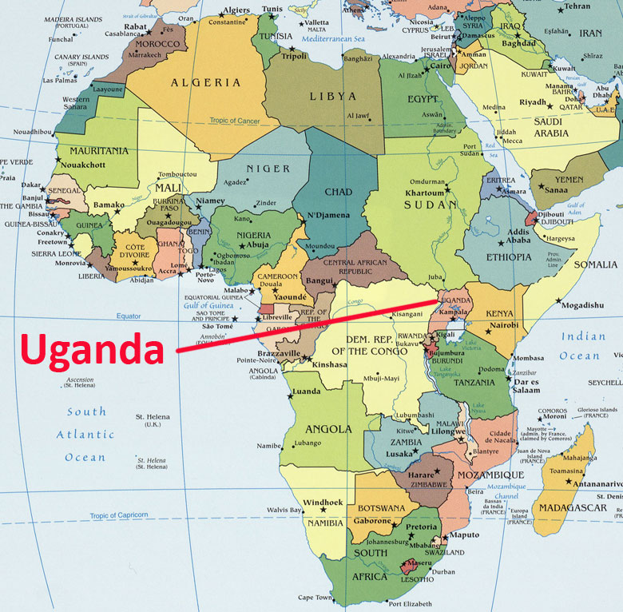
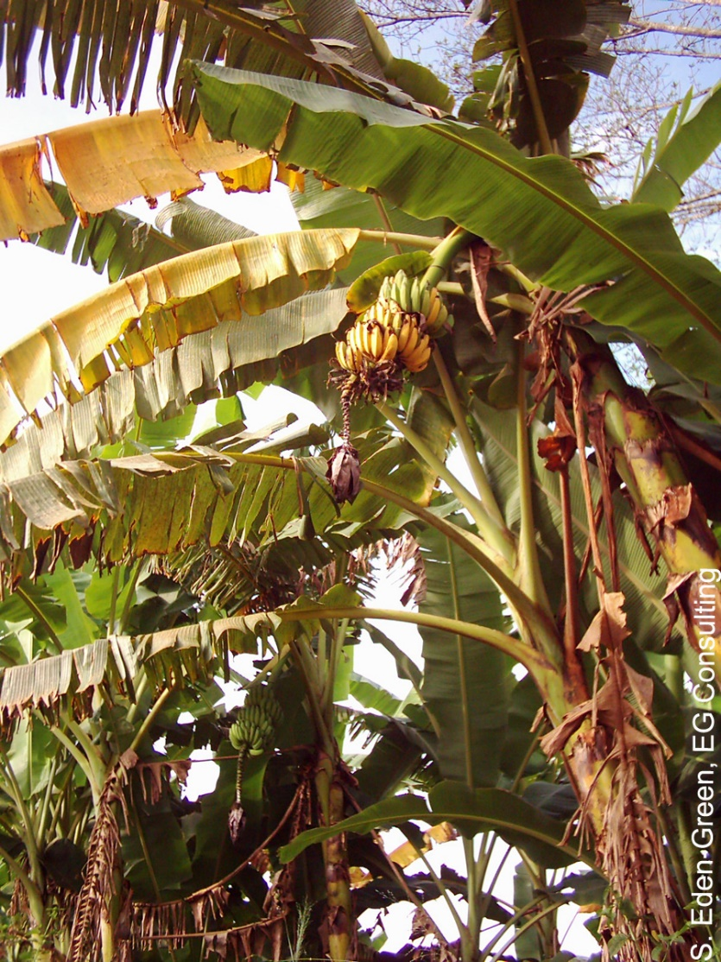
The Banana Problem
Xanthomonas wilt
No natural varieties are resistant so no
traditional breeding solution
BUT
Sweet pepper is resistant to Xanthomonas campestris and two genes are known that mediate this resistance. Using precision techniques these genes have been transferred to banana and these modified bananas are now beginning field trials.

Slide 18
Bangladesh: Bt eggplant
Slide courtesy of Arif Hossain/Cornell Alliance for Science

Slide 19
Food choice is a luxury of the developed world
If you don’t want to eat foods derived by GM techniques, then don’t. It’s your choice
But don’t pretend such foods are dangerous
If anything
They are probably safer than traditional foods

Slide 20
Science Facts
For developed countries food is not a problem.
We must never forget the consequences of our actions for the developing countries
We need more science in politics
And less politics in science

Slide 21
Actions needed around the world
Politicians should listen to the scientists they fund
Stop supporting the idea that foods produced by GMO methods must be inherently dangerous when science shows that they are not
Remove paragraph 72 from the EU report that
“Urges the G8 member states not to support GMO crops in Africa”

Slide 22
CONGREGATION FOR DIVINE WORSHIP AND THE DISCIPLINE OF THE SACRAMENTS
Prot. N. 320/17
Circular letter to Bishops on the bread and wine for the Eucharist
.
.
.
.
5. The same Congregation also decided that Eucharistic matter made with genetically modified organisms can be considered valid matter (cf. Letter to the Prefect of the Congregation for Divine Worship and the Discipline of the Sacraments, 9 December 2013, Prot. N. 89/78 – 44897).

Slide 23
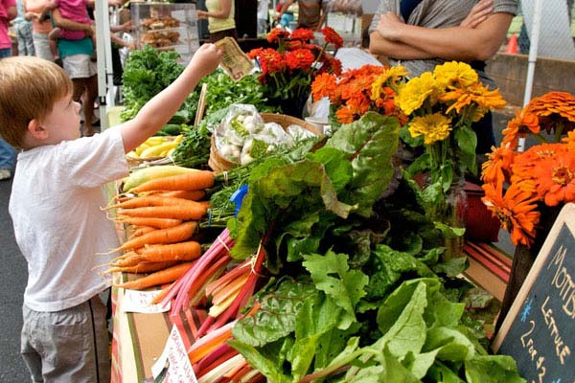
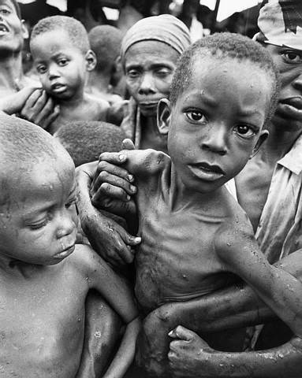
Have a heart
Non-GMO is a Western indulgence of the rich
It doesn’t work for the poor in Africa
http://supportprecisionagriculture.org/

