Slide 1

Why you should embrace GMOs
Richard J. Roberts
Hong Kong Science Museum
March 30th 2019

Slide 2
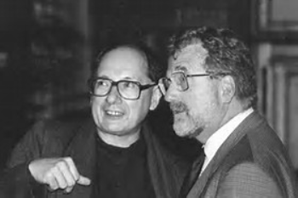
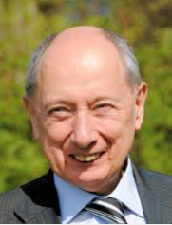
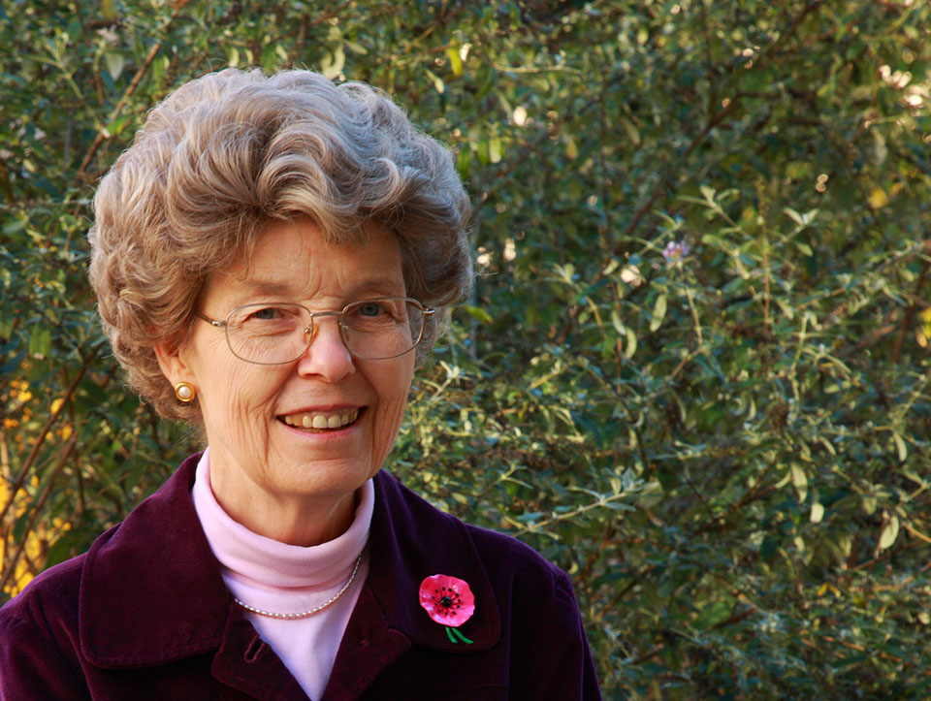
Marc Van Montagu and Jeff Schell
discoverers of Ti plasmid transformation
also independently, Mary Dell Chilton

Slide 3
Remember that for the 800 million who go to bed hungry at night
FOOD is MEDICINE

Slide 4
Nobel Laureates call for science honesty about GMOs
Conceived in December, 2013
Planned during 2014-2015
Formal organization begun in July, 2015
Launched June 30th, 2016
We call on the Green parties to stop scaring the public by pretending that GMO foods must be banned because they are dangerous.

Slide 5
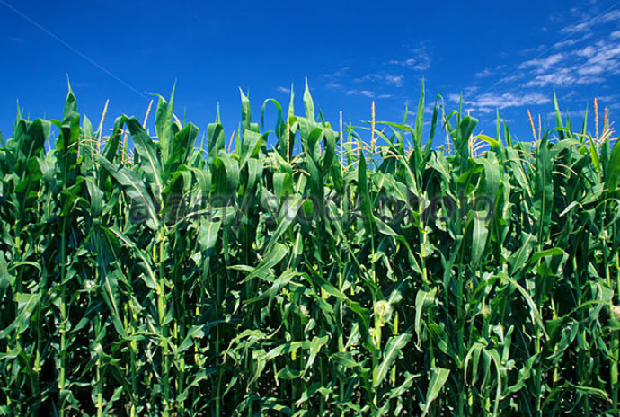
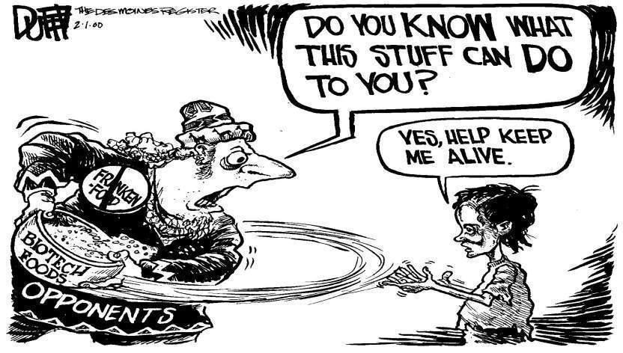
142 Nobel Laureates have written an open letter to Greenpeace and every UN Ambassador urging an acknowledgment that GMO technology is basically safe and should be supported for the sake of the developing world, who desperately need better yielding crops with added nutritional value.
http://supportprecisionagriculture.org/

Slide 6

Food means Agriculture
For 10-12,000 years we had been using crude genetics
But in the 1980’s we learned how to be precise

Slide 7
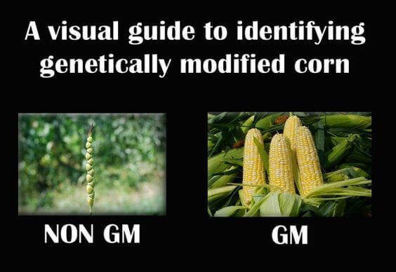
Teosinte
the wild ancestor
GM by Nature
Modern corn
In our supermarkets
GM by man

Slide 8
+X
+X
“Elite”
Variety
Related
Variety with
Desired Trait
First Hybrid
“Elite”
Variety
Backcross
Desired
Variety

Slide 9

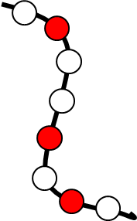


And if that doesn’t work, then mutagenize
with radiation or chemicals

Slide 10
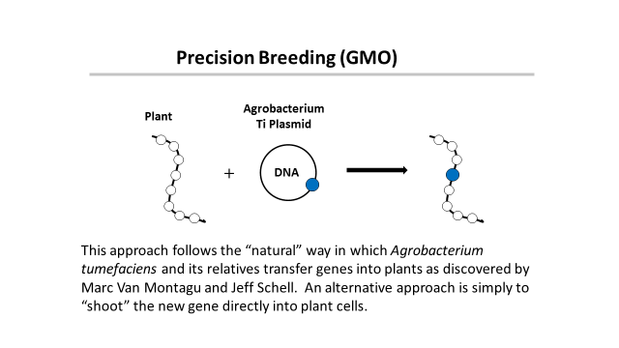

Slide 11
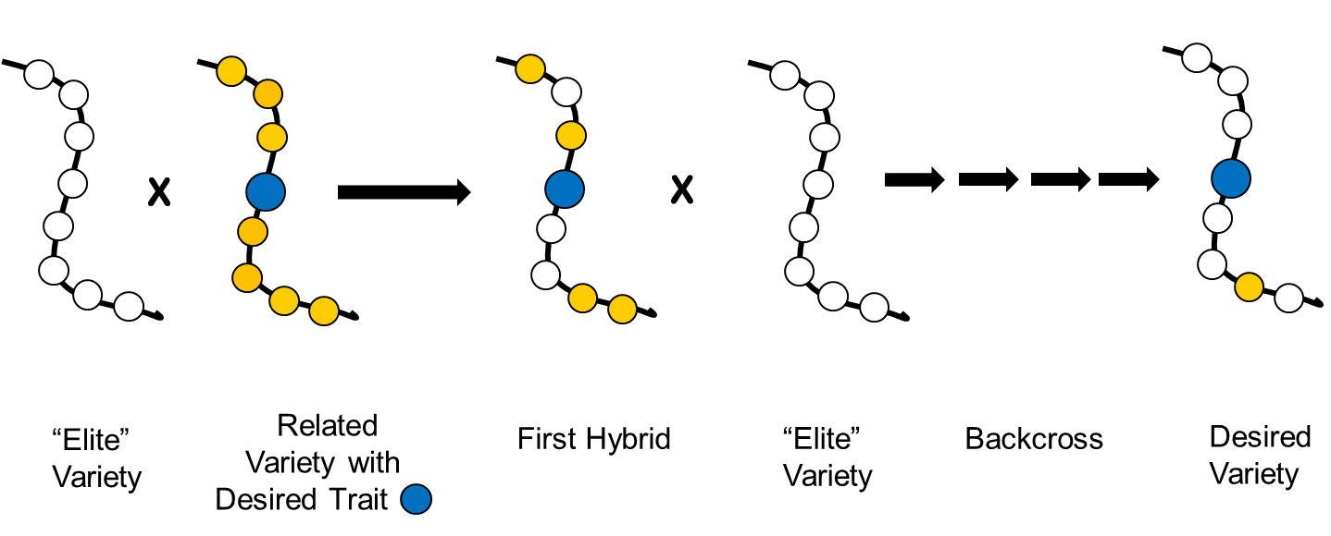
Conventional Breeding
Precision Breeding (GMO)
+
DNA
This approach follows the “natural” way in which Agrobacterium tumefaciens and its relatives transfer genes into plants as discovered by Marc Van Montagu and Jeff Schell. An alternative approach is simply to “shoot” the new gene directly into plant cells.
Or
mutagenize
‘This is safe!’
← Greenpeace says →
‘This is dangerous!’

Slide 12
Traditional versus precision methods
I want to move a GPS system from my old car into my new one
Should I disassemble two cars, mix up the parts and then “select” for the one with the GPS, ignoring what else it might have picked up?
Or should I take the GPS from one car and move it to the other?

Slide 13

Traditional versus precision methods
If I take a GPS from an airplane
will the new car fly?

Slide 14
GMO refers to a method
But what is important is the
PRODUCT
not the
METHOD
This is just as true for traditional breeding

Slide 15
Plant safety
Are all plants safe to eat?
of course not
But why not?

Slide 16
Plants can’t run away from predators
So how do they protect themselves?
With pesticides!

Slide 17
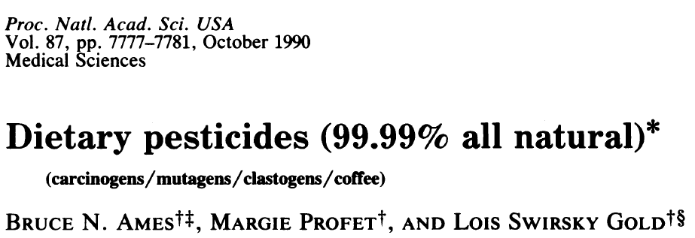
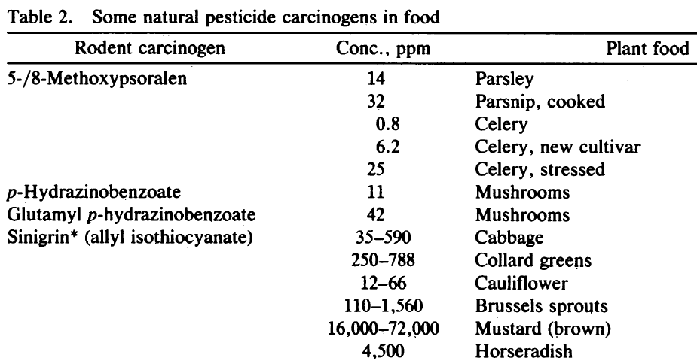
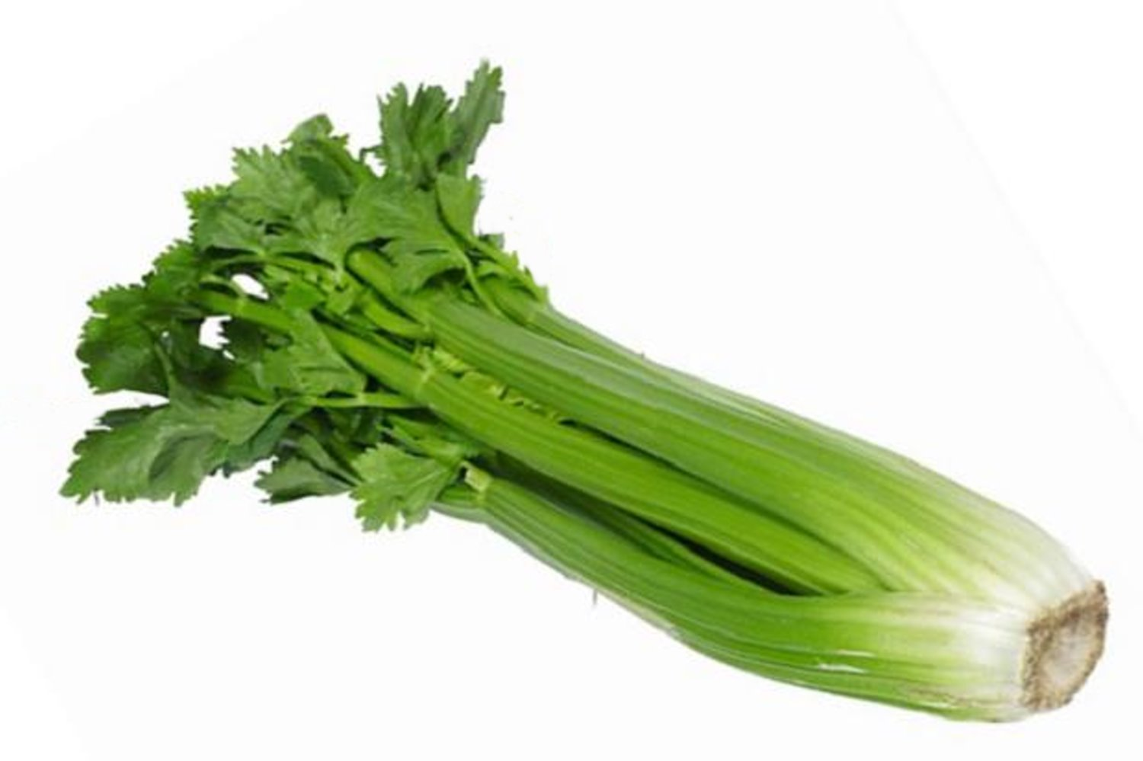
Many common vegetables have high levels of natural pesticides.
See Seligman et al.
Arch Dermatol
123: 1478 (1987)
+ 11 more

Slide 18

Food in Developing Countries
Africa, S. America, Asia need better crops with higher yields.
They need precision agriculture (GMOs)
Europe doesn’t
So why does Europe hate GMO’s?
Could it be politics, or money or both?

Slide 19
The Real Problem
Europeans did not want US companies to control their food
How can that be prevented?
Ban Monsanto and the other big US agribusinesses
Not so fast - the farmers buy their seeds from them

Slide 20
The Green Parties Solution
Assert that GMOs might be dangerous!
The politicians and the green parties will protect
you from this risk by banning GMOs
Best of all
This has no economic consequence for Europe
because European farmers didn’t need GMO’s !

Slide 21
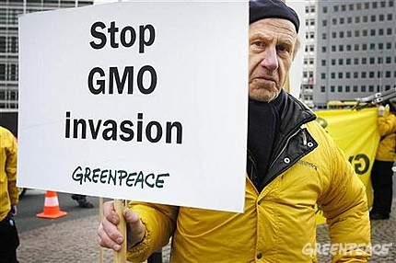
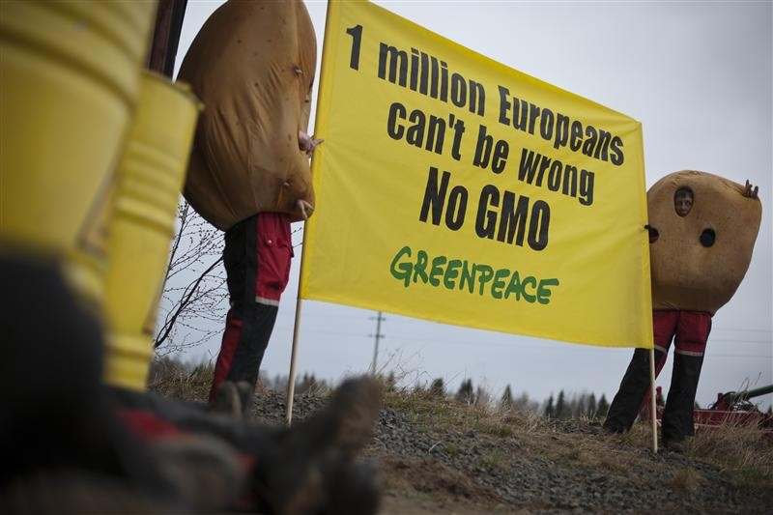
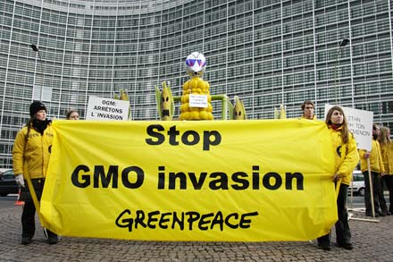
The tragic consequences
Not content with blocking precision agriculture in Europe many politicians and NGOs like “Greenpeace” and “Friends of the Earth” are now spreading their message to the developing countries

Slide 22
Accredited Professional Scientific and/or Medical bodies with an opinion on the safety of GMOs
Overwhelmingly Positive
Royal Society (London)
The U.S. National Research Council (NRC)
U.S. National Academy of Sciences (NAS)
The American Medical Association, (AMA)
U.S. Department of Agriculture (USDA)
U.S. Environmental Protection Agency (EPA)
U.S. Food and Drug Administration (FDA)
European Food Safety authority (EFSA)
American Society for Plant Biology (ASPB)
World Health Organization (WHO)
Food and Agriculture Organization (FAO)
Brazil National Academy of Science,
Chinese National Academy of Science
Indian National Academy of Science
Mexican Academy of Science
Third World Academy of Sciences
+ >200 others
Completely Negative
X Institute for Responsible Technology (Geoffrey Smith)
X American Academy of Environmental Medicine
Courtesy of Martina Newell-McGloughlin

Slide 23
A case study
Vitamin A-deficiency
Global population mortality (in millions)
Vitamin A-deficiency | 1.9-2.7
HIV/Aids | 1.7
Tuberculosis | 1.4
Malaria | 0.75
*Courtesy of Ingo Potrykus
Notes:
Golden Rice and Beyond – challenges of a humanitarian GMO project.

Slide 24
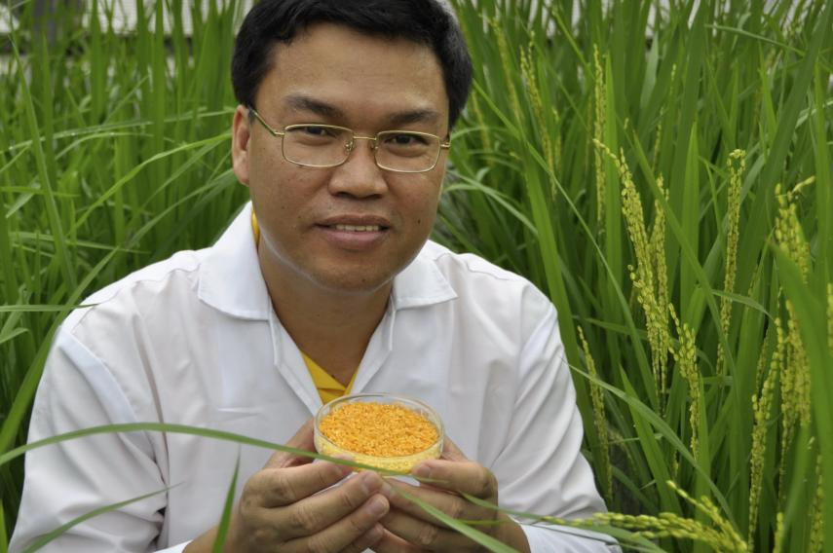
Golden Rice
A new source of Vitamin A
Produce β-carotene in rice
Ingo Potrykus, ETH Zurich
Peter Beyer, U. Freiburg
Courtesy of Ingo Potrykus

Slide 25
Golden Rice
Became a reality in February, 1999.
Could have been in the field within 2-5 years, beginning to save children from blindness and death.
But it’s a GMO and won’t now be available until this year.
Why?
Multiple years of delay due to regulation and opposition.
Notes:
Golden Rice and Beyond – challenges of a humanitarian GMO project.

Slide 26

Science Fiction
Greenpeace blocks development
And then claims
It has taken so long it can’t possibly work

Slide 27
Since 2002 as many as 15 million children have died or suffered because of Vitamin A deficiency
How many must die before we consider this a “crime against humanity” that should be prosecuted?

Slide 28
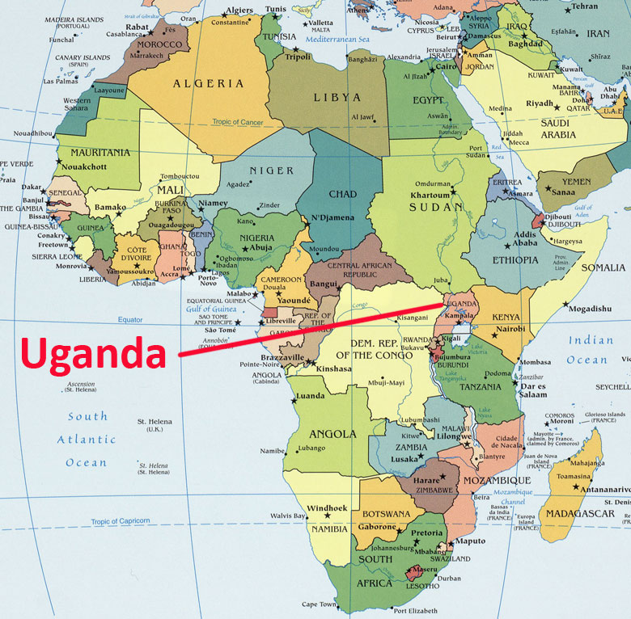
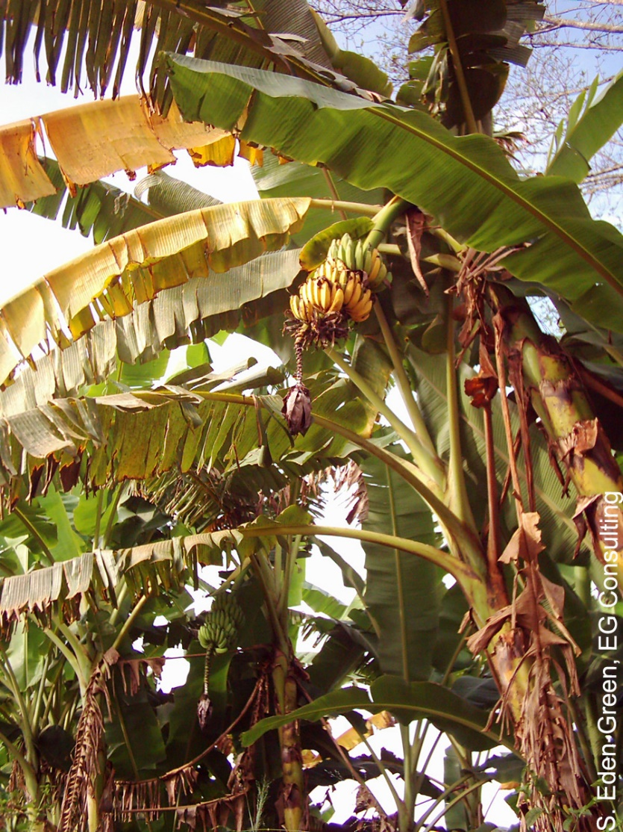
The Banana Problem
Xanthomonas wilt
No natural varieties are resistant so no
traditional breeding solution
BUT
Sweet pepper is resistant to Xanthomonas campestris and two genes are known that mediate this resistance. Using precision techniques these genes have been transferred to banana and these modified bananas work in field trials. But the Ugandan is trying to stop their production.

Slide 29


Slide 30
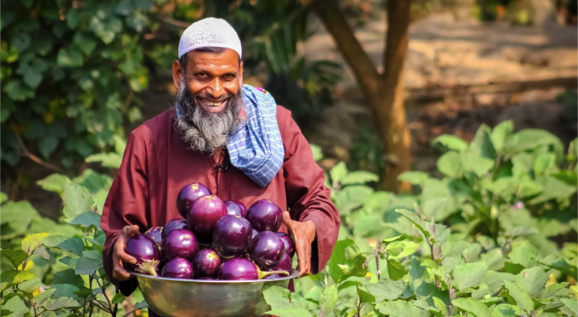
Bangladesh: Bt eggplant
Slide courtesy of Arif Hossain/Cornell Alliance for Science

Slide 31
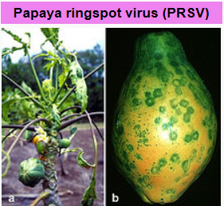
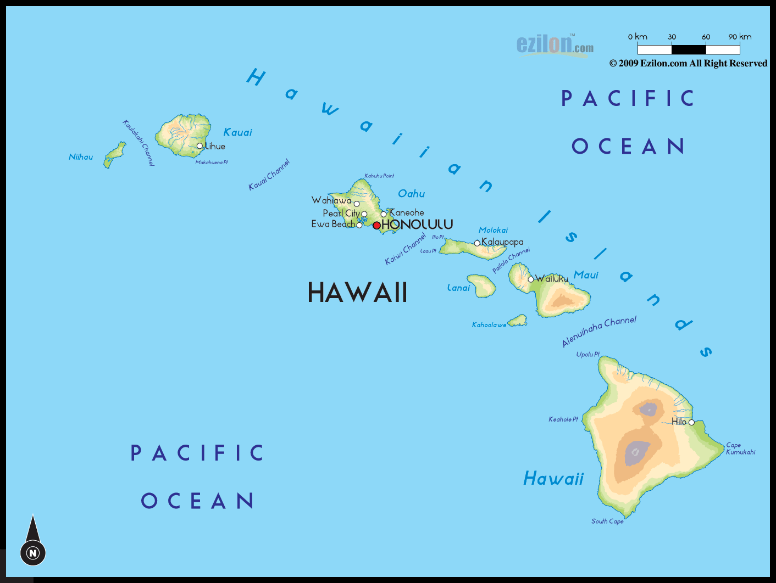
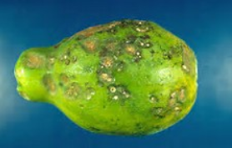

Hawaiian papayas
Almost a disaster

Slide 32
GMO Papaya saves the Hawaiian crop
In the 1990s, Hawaiian papaya trees were plagued by the ringspot virus which decimated half the crop in the state.
In 1998, Dennis Gonsalves from the University of Hawaii developed a transgenic fruit called Rainbow papaya, which is resistant to the virus.
Now 77 percent of the crop grown in Hawaii is genetically engineered and being eaten in the USA.
But in Thailand this solution is banned

Slide 33
Food choice is a luxury of the developed world
If you don’t want to eat foods derived by GM techniques, then don’t. It’s your choice
But don’t pretend such foods are dangerous
If anything
They are probably safer than traditional foods

Slide 34
Science Facts
For developed countries, food is not a problem.
We must never forget the consequences of our actions for the developing countries
We need more science in politics
And less politics in science

Slide 35
Actions needed around the world
Politicians and the public must listen to the scientists they fund
Stop supporting the idea that foods produced by GMO methods must be inherently dangerous when science shows that they are not
Remove paragraph 72 from the EU report that
“Urges the G8 member states not to support GMO crops in Africa”

Slide 36
Civil Society must play its role too
The major religious leaders should speak out
Groups such as the Rotary Clubs should speak out
Influential celebrities should speak out
The media should present science facts not science fiction

Slide 37
CONGREGATION FOR DIVINE WORSHIP
AND THE DISCIPLINE OF THE SACRAMENTS
Prot. N. 320/17
Circular letter to Bishops
on the bread and wine for the Eucharist
.
.
.
.
5. The same Congregation also decided that Eucharistic matter made with genetically modified organisms can be considered valid matter (cf. Letter to the Prefect of the Congregation for Divine Worship and the Discipline of the Sacraments, 9 December 2013, Prot. N. 89/78 – 44897).

Slide 38
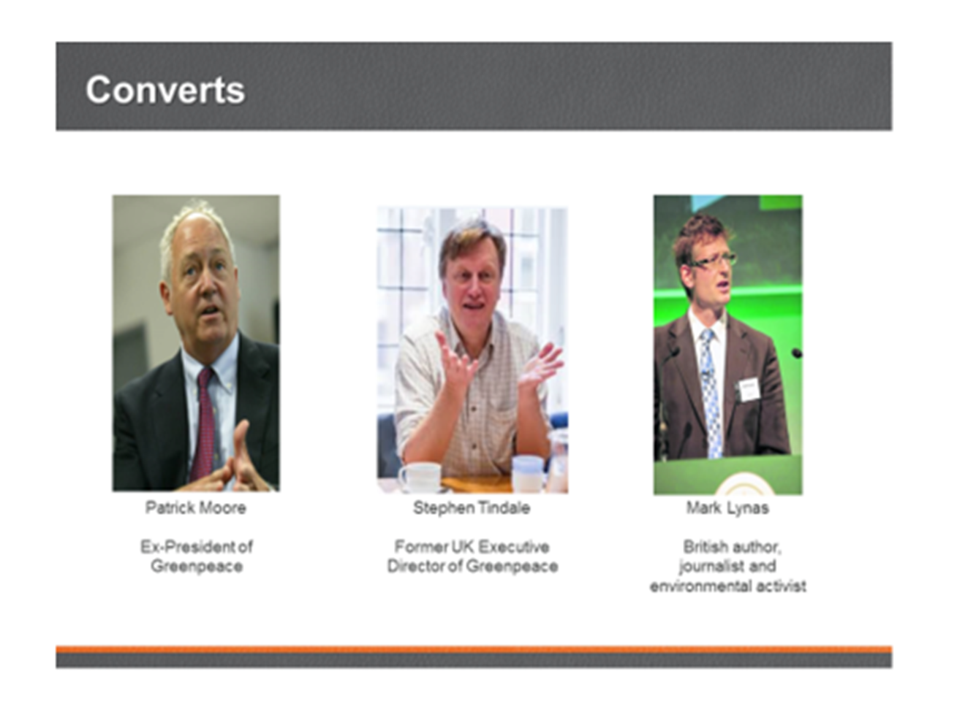
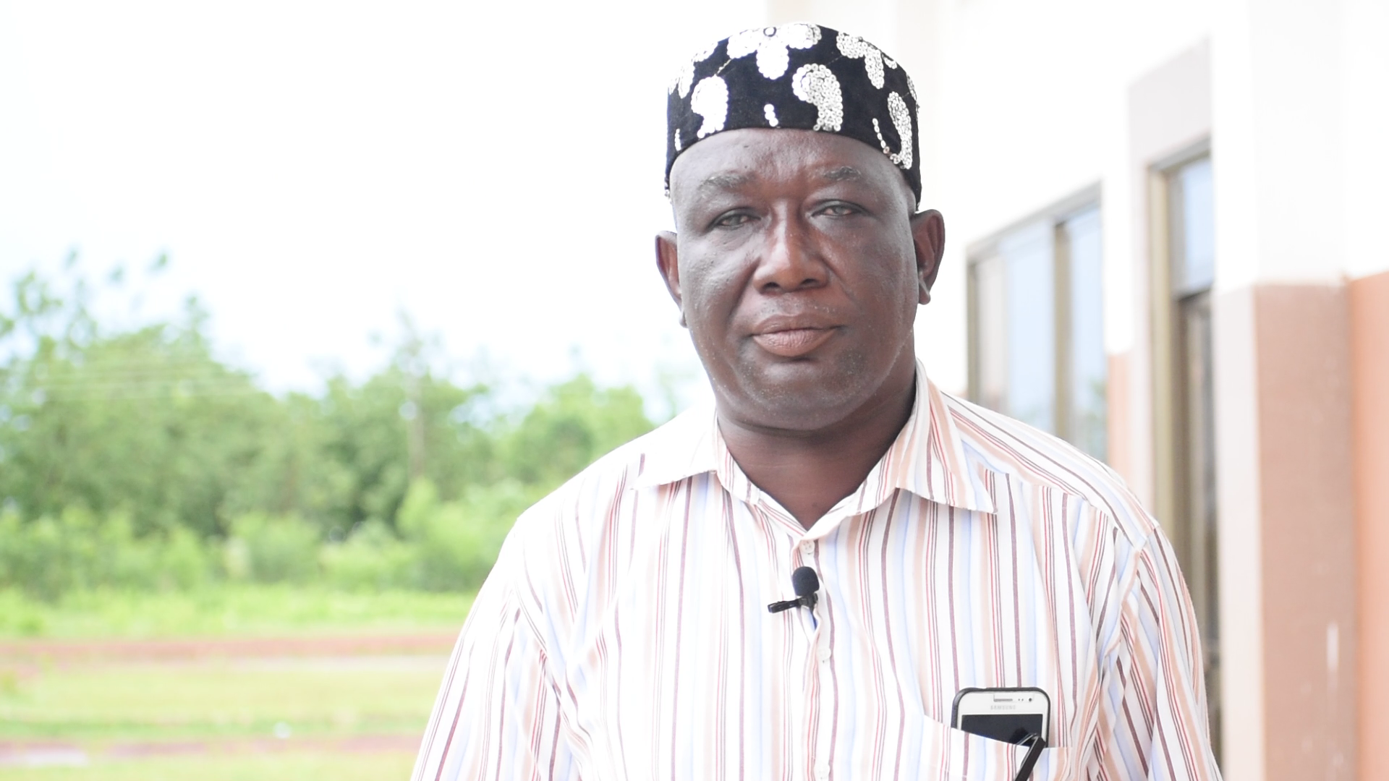
News from Ghana: The former leader of the Peasant Farmers’ Association, Ghana’s primary anti-GMO farmers group, has switched sides to adopt a pro-GMO position.
Mohammed Adams Nasiru attributed his shift to receiving accurate information on agricultural biotechnology from the scientific community.

Slide 39

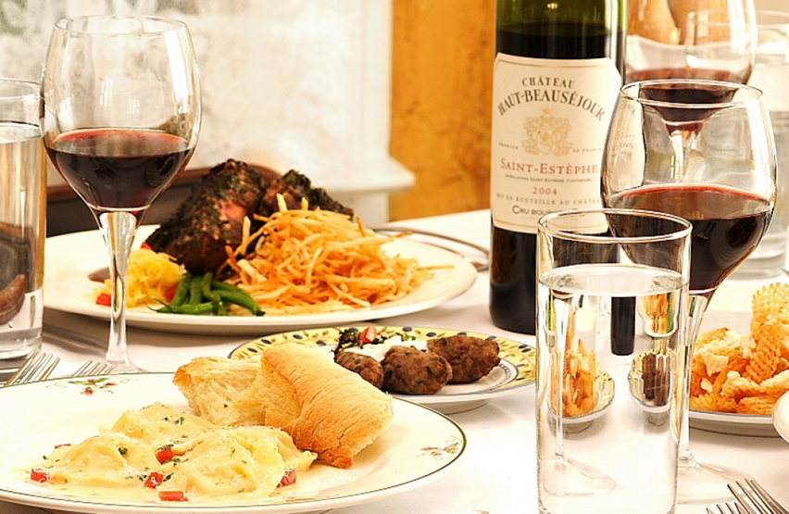
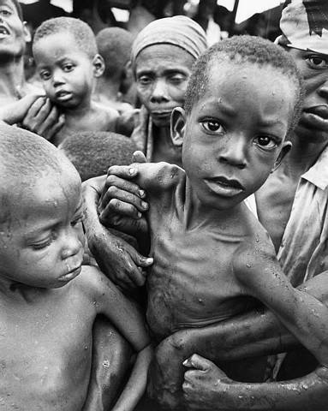
Have a heart
Non-GMO is a Western indulgence of the rich
It doesn’t work for the poor in Africa
http://supportprecisionagriculture.org/

