Slide 1
Why you should love GMOs
Richard J. Roberts
New England Biolabs

Slide 2
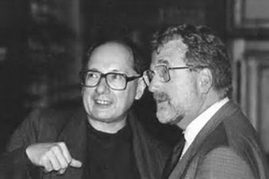
Marc Van Montagu and Jeff Schell
Discoverers of Ti plasmid transformation

Slide 3
Medicine for the developed countries
Cutting edge solutions
High costs may be acceptable
Medicine for the developing countries
Practical solutions needed
Costs must be low

Slide 4
Medicine for the developing countries
Vaccines (tropical diseases)
Cheap drugs (targeted antibiotics, antivirals)
Basic care (pregnancy, primary diagnosis)
! FOOD !

Slide 5
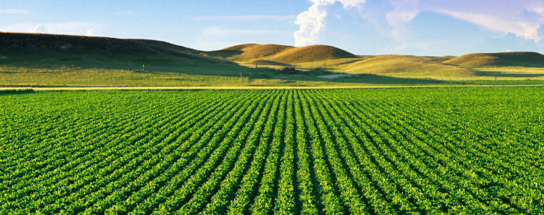
Food means Agriculture
For 10-12,000 years we have been using crude genetics
But in the 1980’s we learned how to be precise

Slide 6
Conventional plant breeding
GM plant breeding
And if that doesn’t work then there’s always
Chemical mutagenesis Irradiation
Precision Agriculture
‘This is safe!’
← Greenpeace says →
‘This is dangerous!’
*Images found on csiro.au

Slide 7
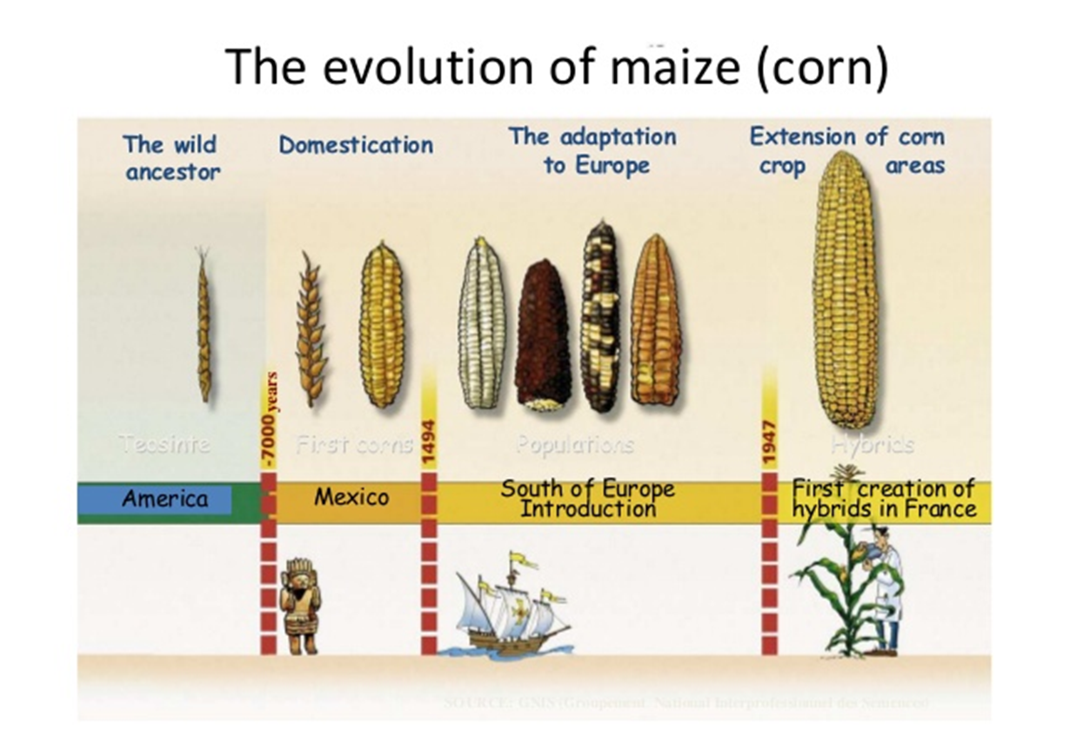
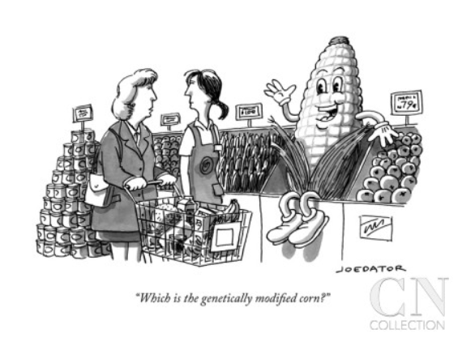

Slide 8
Traditional versus precision methods
I want to move a GPS system from my old car into my new one
Should I disassemble two cars, mix up the parts and then “select” for the one with the GPS, ignoring what else it might have picked up?
Or should I take a GPS from one car and move it to the other?

Slide 9
Traditional versus precision methods
If I take a GPS from an airplane
will the new car fly?

Slide 10
GMO refers to a method
What is important is the
PRODUCT
not the method

Slide 11
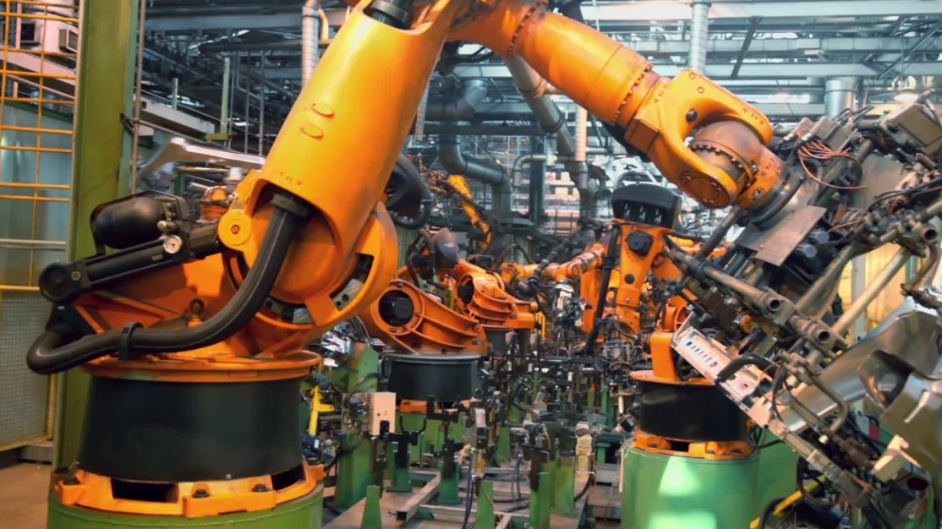
PRODUCTION LINE

Slide 12
It’s the “PRODUCT” that matters

Slide 13
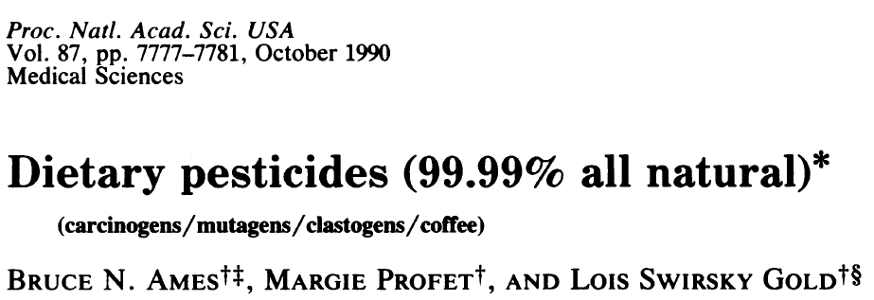
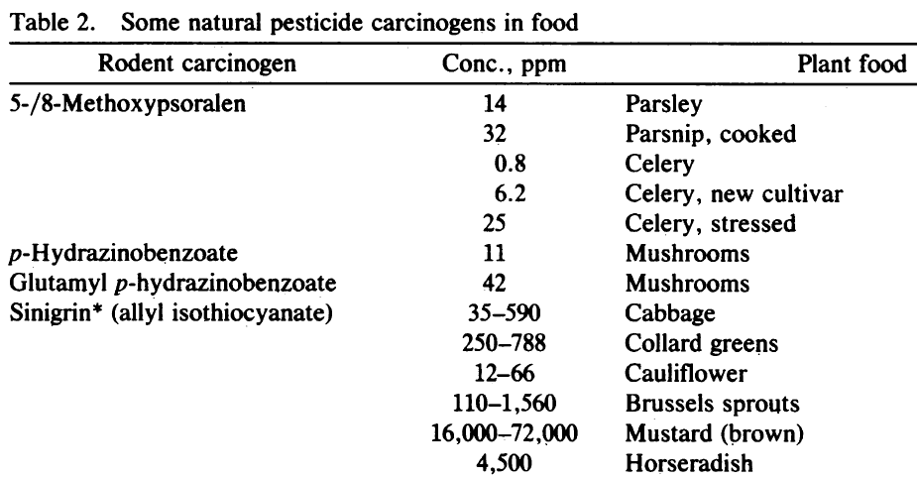
Many common vegetables have high levels of natural pesticides.
+ 11 more

Slide 14
Food in Developing Countries
Africa, S. America, Asia need better crops with high yields. They need precision agriculture (GMOs)
Europe doesn’t
So why doesn’t Europe endorse this?
Could it be politics, or money or both?

Slide 15
The Problem
Europeans did not want US companies to control their food
How can that be prevented?
Ban Monsanto and the other big US agribusinesses
Not so fast - the farmers buy their seeds from them

Slide 16
The Green Parties Solution
Assert that precision agriculture might be dangerous!
The politicians and the green parties will protect you from this risk by banning GMOs
Best of all:
This has no economic consequence for Europe !

Slide 17
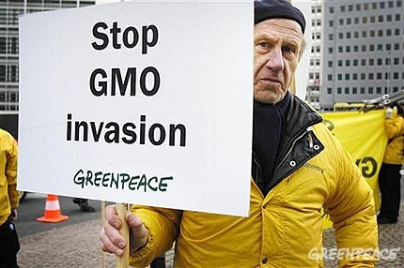
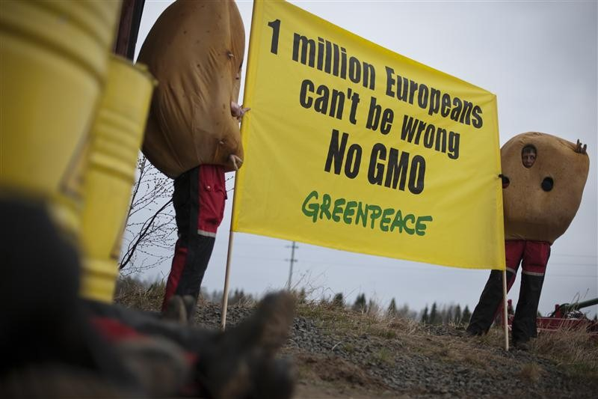
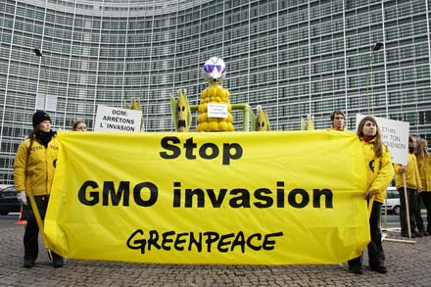
The tragic consequences
Not content with blocking precision agriculture in Europe many politicians and NGOs like “Greenpeace” and “Friends of the Earth” are now spreading their message to the developing countries

Slide 18
One case study
Vitamin A-deficiency (2014 data)
Global population mortality (in millions):
Vitamin A-deficiency | 1.4-2.1
HIV/Aids | 1.2
Tuberculosis | 1.1
Malaria | 0.6
*Courtesy of Ingo Potrykus
Notes:
Golden Rice and Beyond – challenges of a humanitarian GMO project.

Slide 19
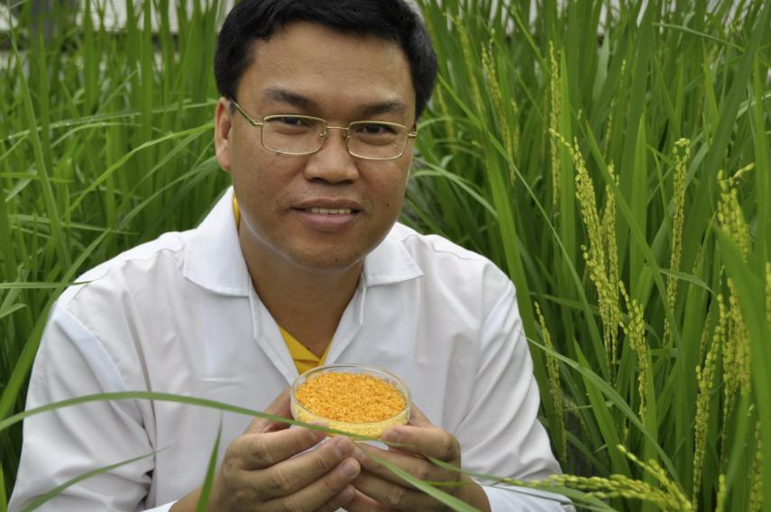
Golden Rice
A new source of Vitamin A
Ingo Potrykus, ETH Zurich
Peter Beyer, U. Freiburg
Courtesy of Ingo Potrykus

Slide 20
Golden Rice
Became a reality in February 1999.
Could have been in use in 2002 saving millions of children from blindness and death.
But it’s a GMO and won’t now be available until at least 20**.
Why?
14+ years of delay due to regulation and opposition.
Courtesy of Ingo Potrykus
Notes:
Golden Rice and Beyond – challenges of a humanitarian GMO project.

Slide 21
Accredited Professional Scientific and/or Medical bodies with an opinion on the safety of GMOs
Generally Positive
Royal Society (London)
The U.S. National Research Council (NRC)
U.S. National Academy of Sciences (NAS)
The American Medical Association, (AMA)
U.S. Department of Agriculture (USDA)
U.S. Environmental Protection Agency (EPA)
U.S. Food and Drug Administration (FDA)
European Food Safety authority (EFSA)
American Society for Plant Biologists (ASPB)
World Health Organization (WHO)
Food and Agriculture Organization (FAO)
Brazil National Academy of Science,
Chinese National Academy of Science
Indian National Academy of Science
Mexican Academy of Science
Third World Academy of Sciences
Generally Negative
Institute for Responsible Technology (Geoffrey Smith)
American Academy of Environmental Medicine
Courtesy of Martina Newell-McGloughlin

Slide 22
Since 2002 more than 15 million children have died or suffered because of Vitamin A deficiency
How many must die before we consider this a “crime against humanity” that should be prosecuted?

Slide 23
Some common “Green parties’ fabrications”
Massive amounts of Golden Rice are needed to get sufficient Vitamin A
Indian farmers’ suicides are linked to biotechnology advances
Pesticide use increases for GMOs

Slide 24
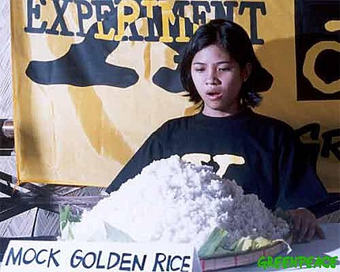
Golden Rice needed per person per day
Greenpeace: 9kg cooked rice, 3.5kg dry rice
In reality: 150g cooked rice, 50g dry rice

Slide 25
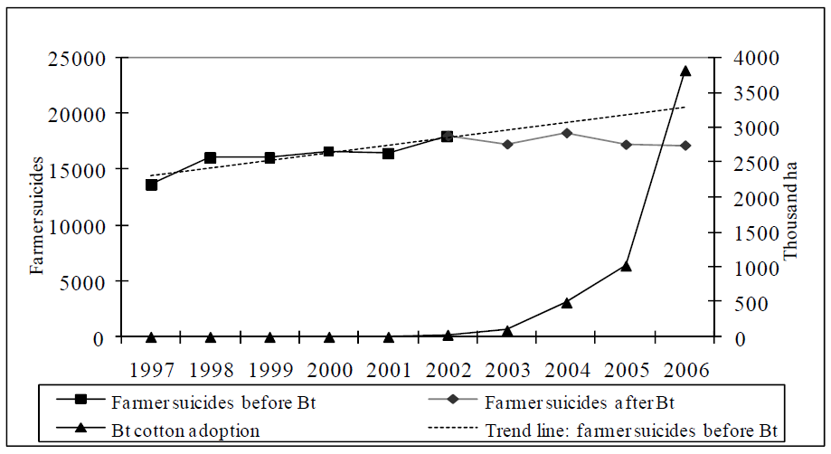
Indian farmers’ suicides are NOT linked to biotechnology advances
Source: http://ebrary.ifpri.org/cdm/ref/collection/p15738coll2/id/14501

Slide 26
The pesticide myth
Bt cotton in India
 | Pesticide use | Yield
2001 | 5,748 metric tons | 308 kg
2013 | 222 metric tons | 550 kg

Slide 27
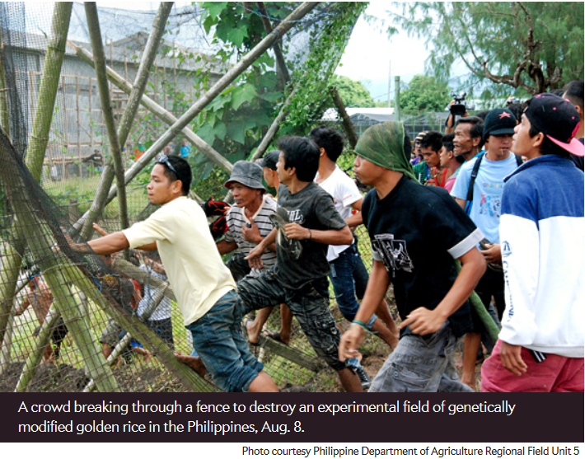

Slide 28
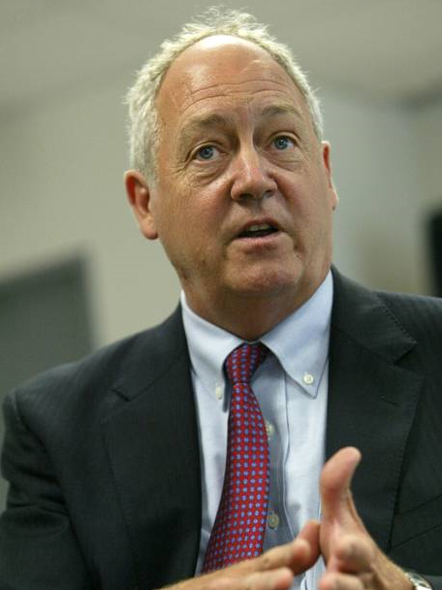
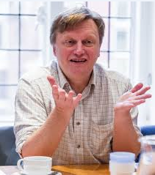
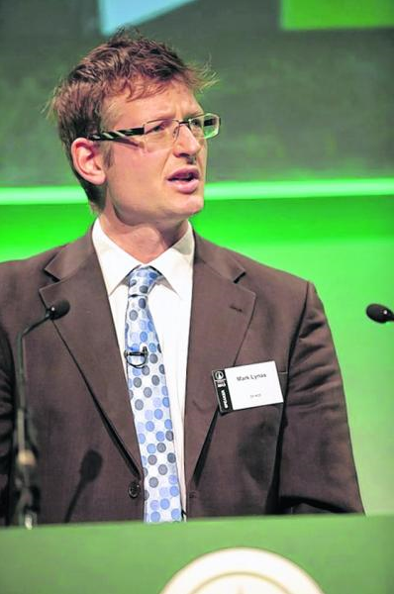
Converts
Patrick Moore
Ex-President of Greenpeace
Stephen Tindale
Former UK Executive Director of Greenpeace
Mark Lynas
British author, journalist and environmental activist

Slide 29
If you don’t want to eat GMOs then don’t
But don’t pretend they are dangerous
They are not
They’re probably safer than traditional foods
roberts@neb.com

Slide 30
Conclusions
For developed countries food is not a problem
But let’s not forget the consequences of our actions for the developing countries
We need more science in politics and less politics in science
roberts@neb.com

Slide 31
And let’s encourage the media to become more responsible too!
roberts@neb.com

