Slide 1
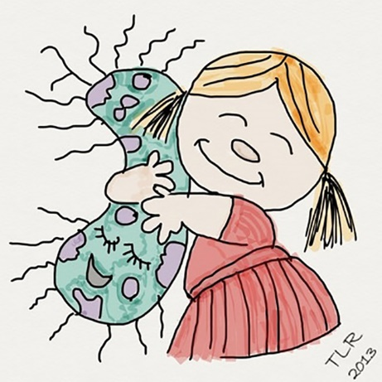
The Future of Advocacy: When Science and Research are not enough.
The Case of GMOs
Richard J. Roberts
Oxford, Sept 29th 2018

Slide 2
Initiatives Which Laureates How many?
Open Access publication (2001) Science 49
Libya (Bulgarian nurses) (2006) All 119
Daw Aung San Suu Kyi (2009) All 219
Liu Xiaobo (2010) All 155
CIRCB, Cameroon (2012) Medicine/Chemistry 44
GMO (2015) All 137

Slide 3
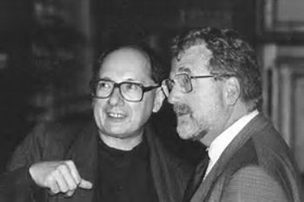
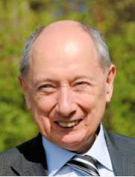
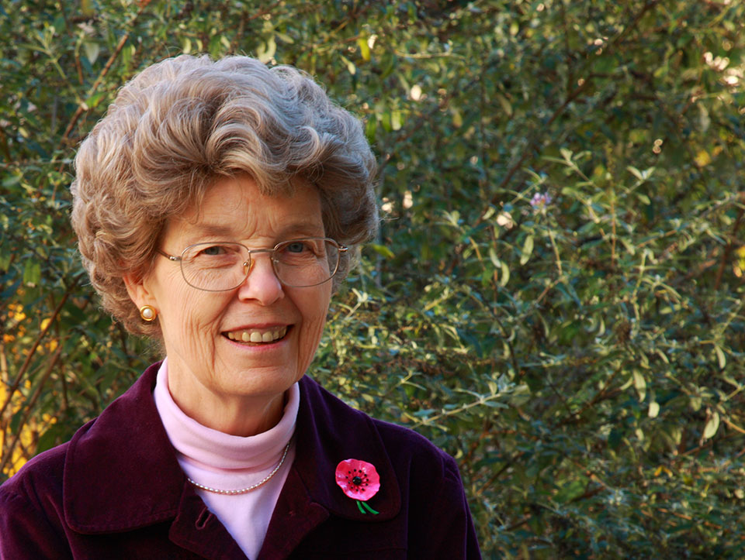
Marc Van Montagu and Jeff Schell
Discoverers of Ti plasmid transformation
together with Mary Dell Chilton

Slide 4
Remember that for the 800 million who go to bed hungry at night
FOOD is MEDICINE

Slide 5
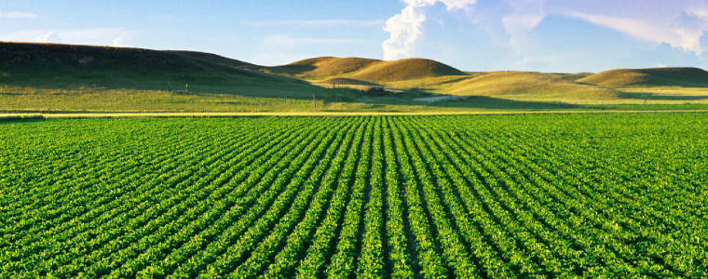
Food means Agriculture
For 10-12,000 years we had been using crude genetics
But in the 1980’s we learned how to be precise

Slide 6
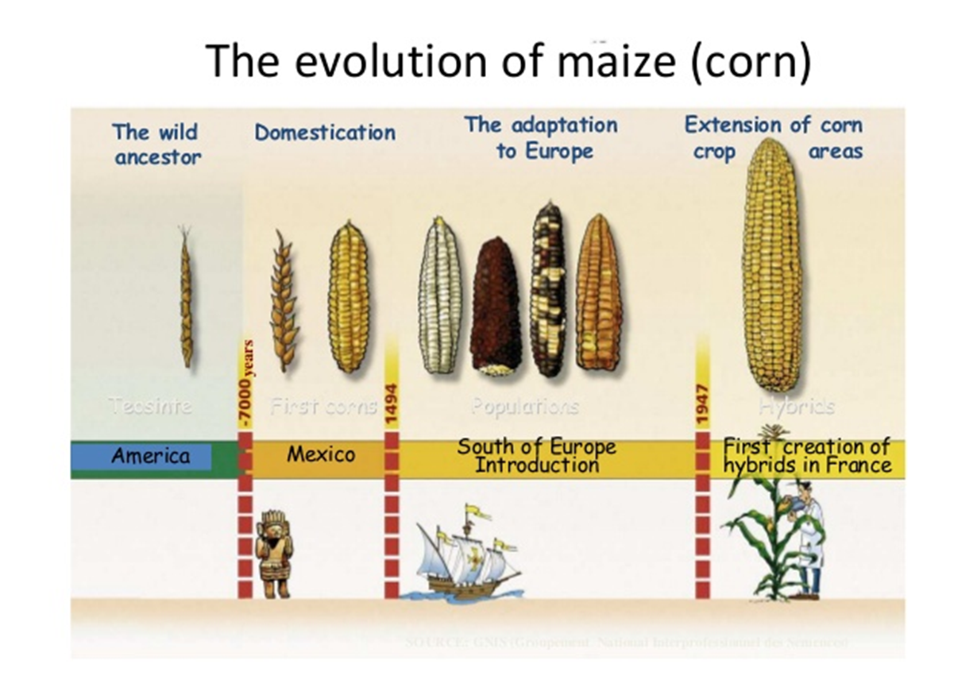

Slide 7
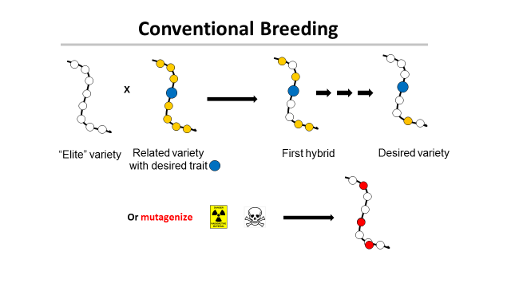
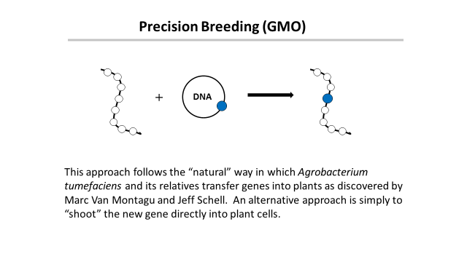
‘This is safe!’
← Greenpeace says →
‘This is dangerous!’

Slide 8
Traditional versus precision methods
I want to move a GPS system from my old car into my new one
Should I disassemble two cars, mix up the parts and then “select” for the one with the GPS, ignoring what else it might have picked up?
Or should I take the GPS from one car and move it to the other?

Slide 9
Traditional versus precision methods
If I take a GPS from an airplane
will the new car fly?

Slide 10
GMO refers to a method
But what is important is the
PRODUCT
not the
METHOD
This is just as true for traditional breeding

Slide 11
A case study
Vitamin A-deficiency
Global population mortality (in millions)
Vitamin A-deficiency | 1.9-2.7
HIV/Aids | 1.7
Tuberculosis | 1.4
Malaria | 0.75
*Courtesy of Ingo Potrykus
Notes:
Golden Rice and Beyond – challenges of a humanitarian GMO project.

Slide 12
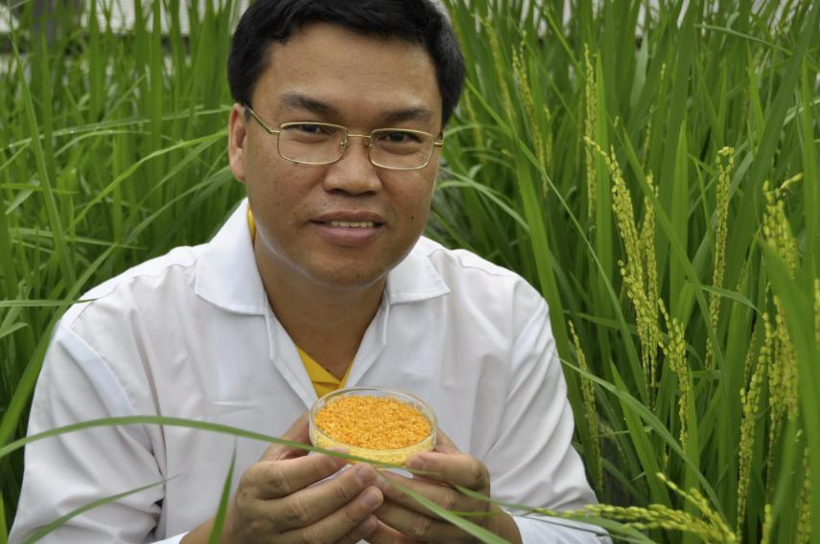
Golden Rice
A new source of Vitamin A
Ingo Potrykus, ETH Zurich
Peter Beyer, U. Freiburg
Courtesy of Ingo Potrykus

Slide 13
Golden Rice
Became a reality in February, 1999.
Could have been in the field within 2-5 years, beginning to save children from blindness and death.
But it’s a GMO and won’t now be available until at least 2018.
Why?
Multiple years of delay due to regulation and opposition.
>15 million children have died or suffered because of VDA
Courtesy of Ingo Potrykus
Notes:
Golden Rice and Beyond – challenges of a humanitarian GMO project.

Slide 14
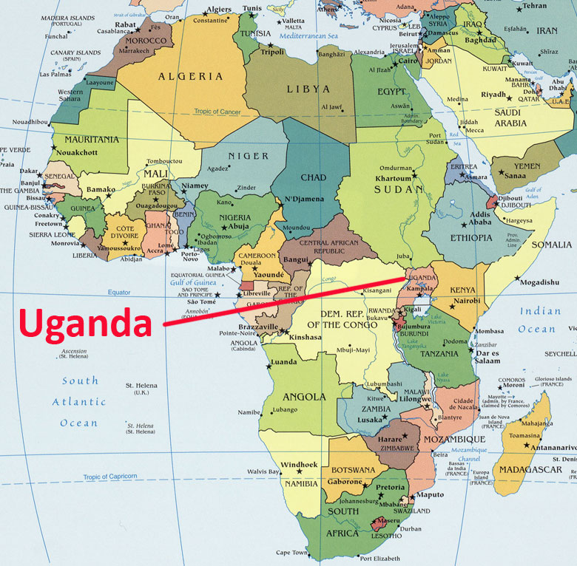
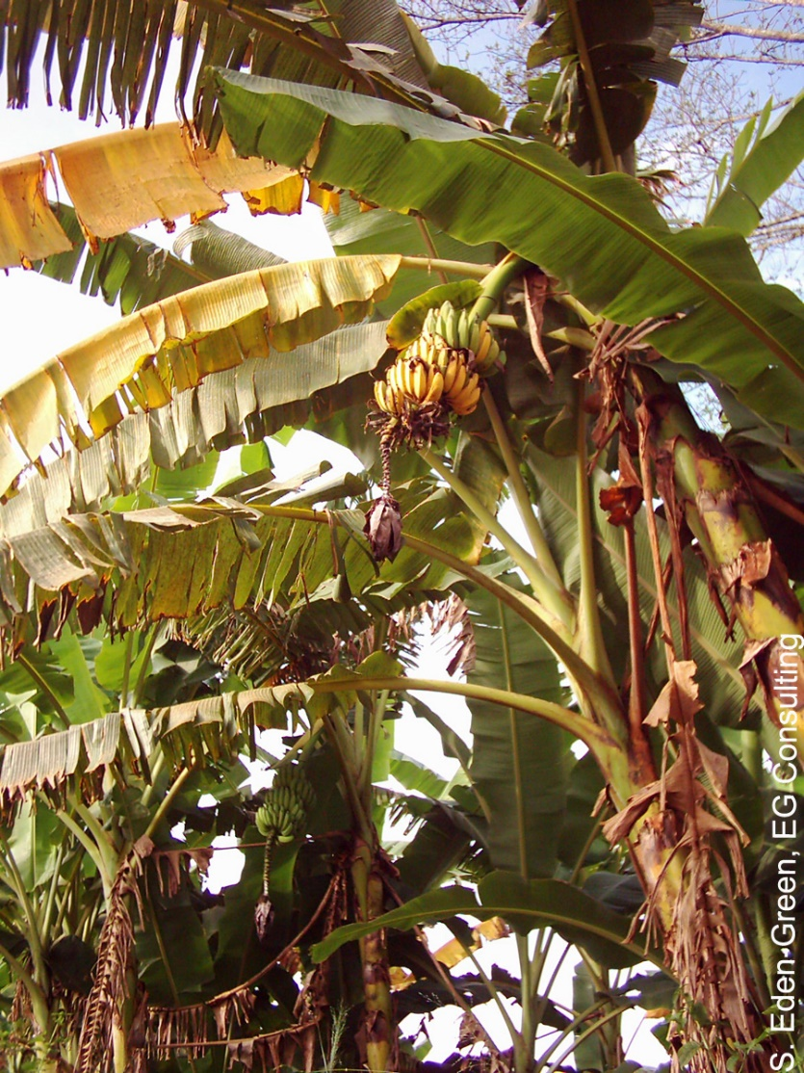
The Banana Problem
Xanthomonas wilt
No natural varieties are resistant so no
traditional breeding solution
BUT
Sweet pepper is resistant to Xanthomonas campestris and two genes are known that mediate this resistance. Using precision techniques these genes have been transferred to banana and these modified bananas are now beginning field trials.

Slide 16
Bangladesh: Bt eggplant
Slide courtesy of Arif Hossain/Cornell Alliance for Science

Slide 17
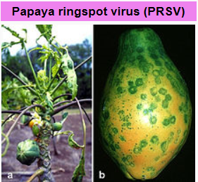
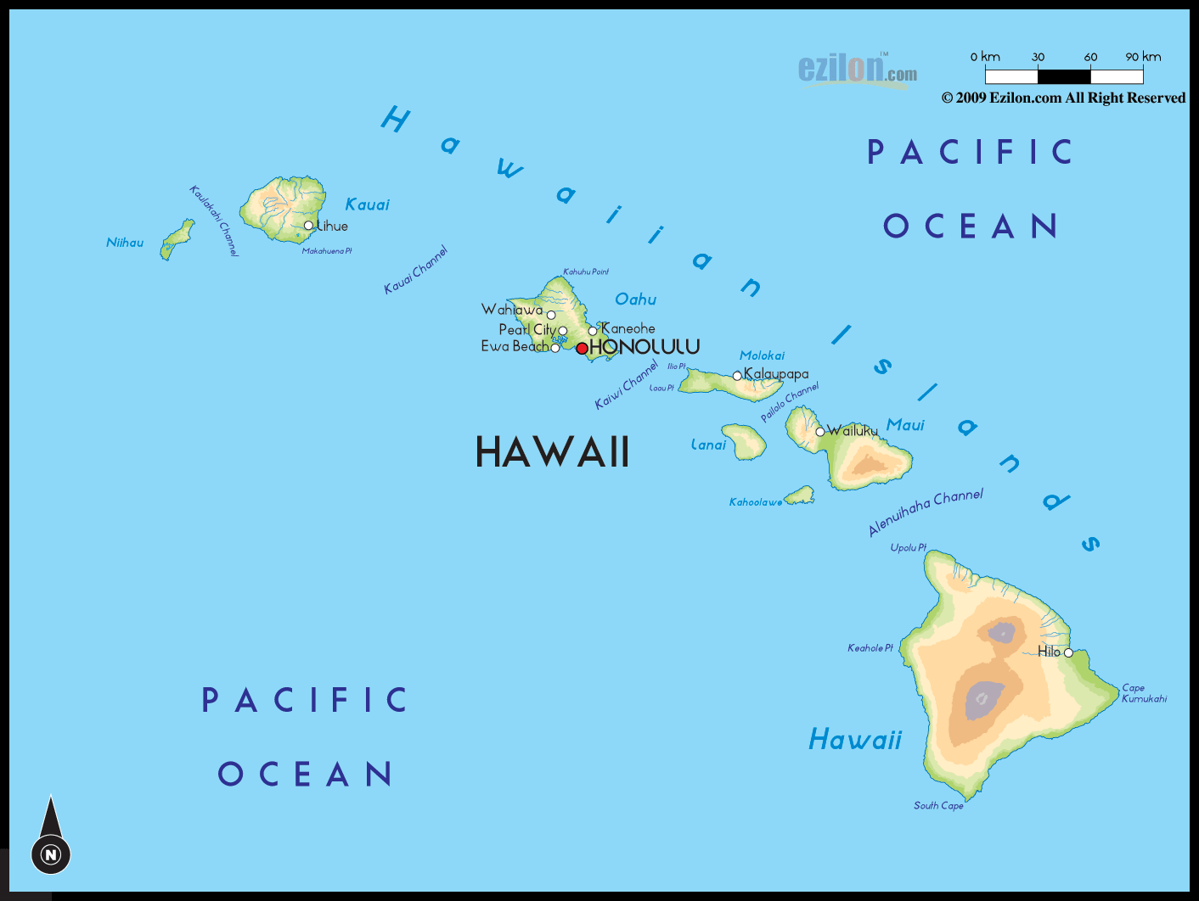
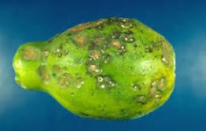
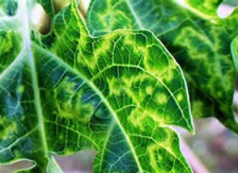
Hawaiian papayas
Almost a disaster

Slide 18
GMO Papaya saves the Hawaiian crop
In the 1990s, Hawaiian papaya trees were plagued by the ringspot virus which decimated half the crop in the state.
In 1998, Dennis Gonzales from the University of Hawaii developed a transgenic fruit called Rainbow papaya, which is resistant to the virus.
Now 77 percent of the crop grown in Hawaii is genetically engineered and being eaten in the USA.
But in Thailand this solution is banned

Slide 19
Food choice is a luxury of the developed world
If you don’t want to eat foods derived by GM techniques, then don’t. It’s your choice
But don’t pretend such foods are dangerous
If anything
They are probably safer than traditional foods

Slide 20
Science Facts
For developed countries food is not a problem.
We must never forget the consequences of our actions for the developing countries
We need more science in politics
And less politics in science

Slide 21
Civil Society must play its role too
The major religious leaders should speak out
Groups such as the Rotary Clubs should speak out
Influential celebrities should speak out
The media should present science facts not science fiction

Slide 22
CONGREGATION FOR DIVINE WORSHIP AND THE DISCIPLINE OF THE SACRAMENTS
Prot. N. 320/17
Circular letter to Bishops on the bread and wine for the Eucharist
.
.
.
.
5. The same Congregation also decided that Eucharistic matter made with genetically modified organisms can be considered valid matter (cf. Letter to the Prefect of the Congregation for Divine Worship and the Discipline of the Sacraments, 9 December 2013, Prot. N. 89/78 – 44897).

Slide 23
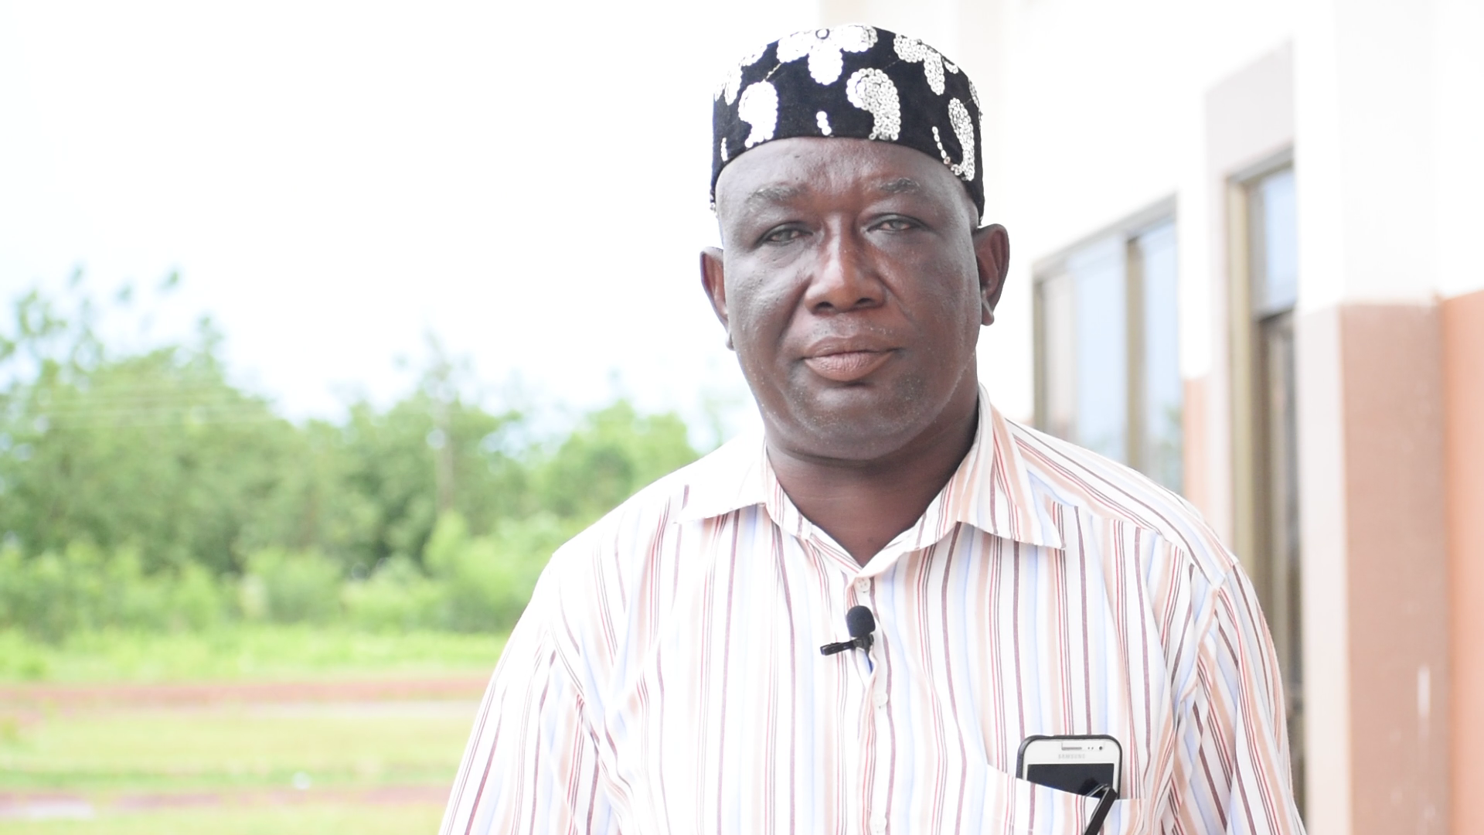
News from Ghana: The former leader of the Peasant Farmers’ Association, Ghana’s primary anti-GMO farmers group, has switched sides to adopt a pro-GMO position.
Mohammed Adams Nasiru attributed his shift to receiving accurate information on agricultural biotechnology from the scientific community.

Slide 24
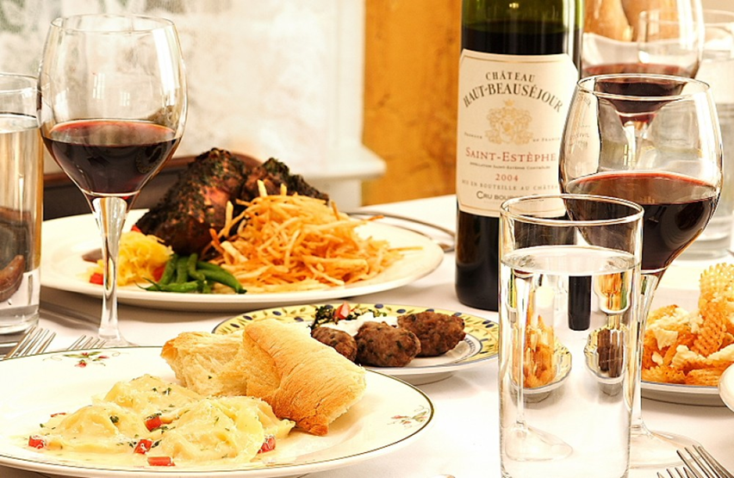
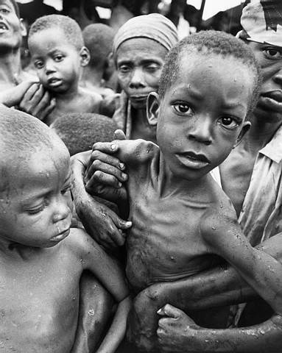
Have a heart
Non-GMO is a Western indulgence of the rich
It doesn’t work for the poor in Africa
http://supportprecisionagriculture.org/

