Slide 1
Combating Hunger and Climate Change with Biotechnology
Richard J. Roberts
ICABR, Bologna, July 6th, 2022
http://supportprecisionagriculture.org/

Slide 2
Climate change is devastating life as we know it
Greenhouse gas emissions are a major problem
BIOENGINEERED CROPS can HELP
Remember that for the 800 million who go to bed hungry at night
FOOD is MEDICINE

Slide 3
The term Genetically Modified Organism is misleading
Every life form on this planet has been genetically modified by evolution
Plant and animal breeding has been practiced for centuries and involves genetic modification.

Slide 4
Hypocrisy abounds within the anti-GMO movement
Why don’t they stop human insulin production for diabetics?
Why do they accept vaccines for COVID-19 within 12 months of development?
Why do they allow millions of tons of GMO products to be used to feed animals for human consumption?

Slide 5
Climate Ready Crops
Julie Gray, Institute for Sustainable Food, University of Sheffield, UK
Stomatal development has been manipulated to produce crops that require lower water inputs and have enhanced drought, disease, and salinity tolerance. Optimization and adoption of this technology could lead to reductions in GHG emissions of 1.67 GtCO₂
Tobias J. Erb, Max Planck Society, Germany
Natural photosynthesis is limited by its CO2-fixation capabilities. Using synthetic biology to introduce new-to-nature CO2-fixation pathways into crops could increase photosynthetic CO2 uptake by 20 to 60%, which translates to an increased uptake of 1.9 to 6.3 Gt C per year on a global scale.

Slide 6
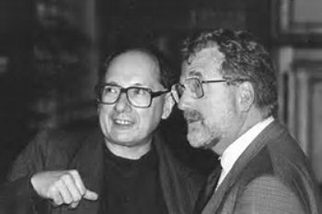
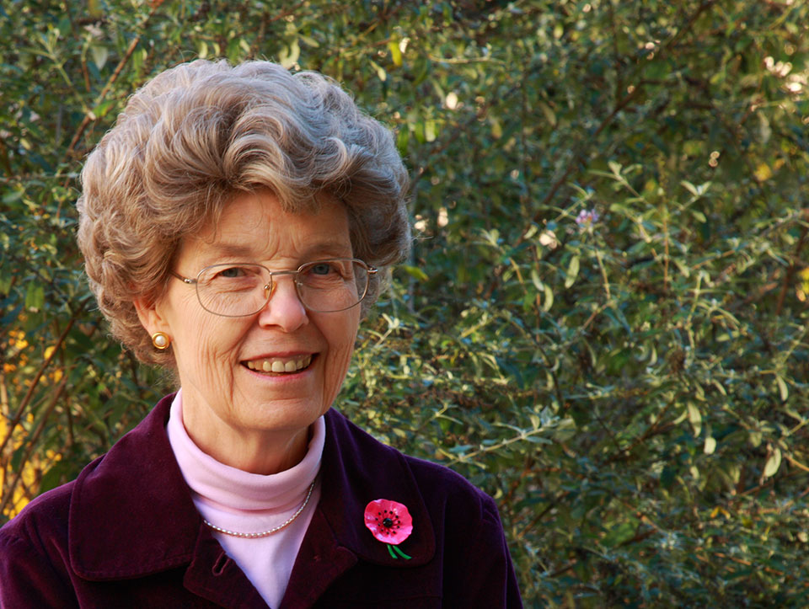
Marc Van Montagu and Jeff Schell
Discoverers of Ti plasmid transformation
together with Mary Dell Chilton

Slide 7
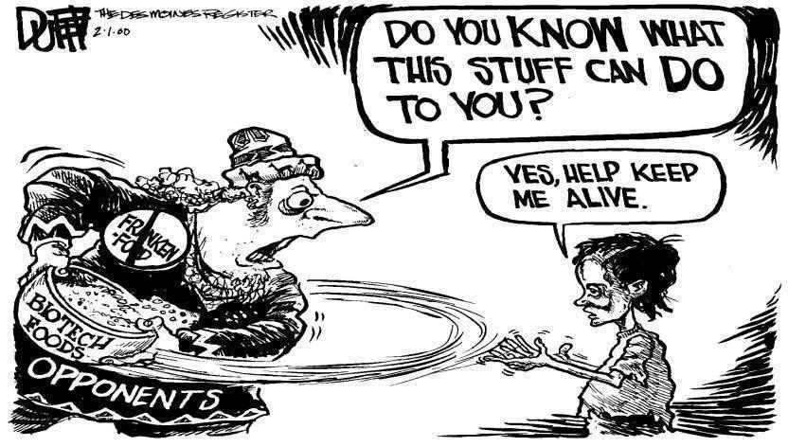
159 Nobel Laureates have supported an open letter to Greenpeace and every UN Ambassador urging an acknowledgment that GMO technology is basically safe and should be supported for the sake of the developing world, who desperately need better yielding crops with added nutritional value.
https://supportprecisionagriculture.org/

Slide 8
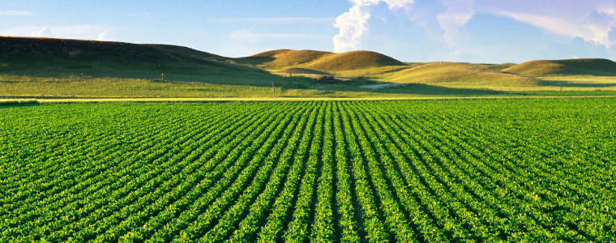
Food means Agriculture
For 10-12,000 years we had been using crude genetics
But in the 1980’s we learned how to be precise

Slide 9
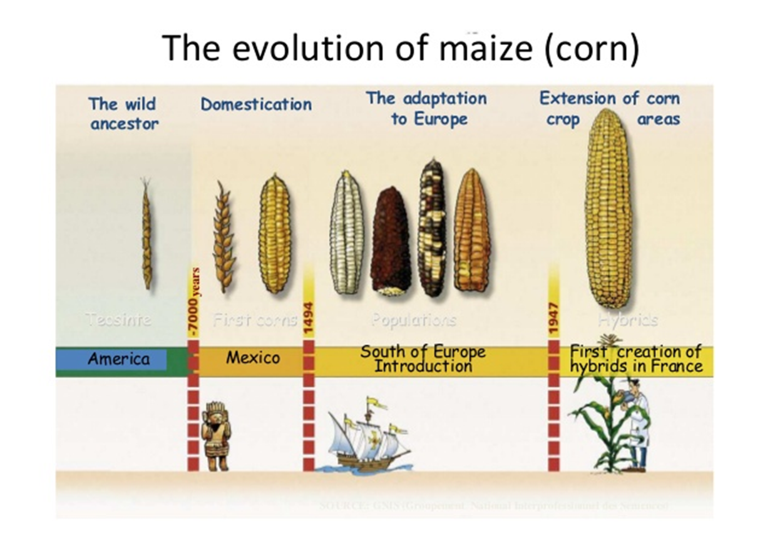

Slide 10
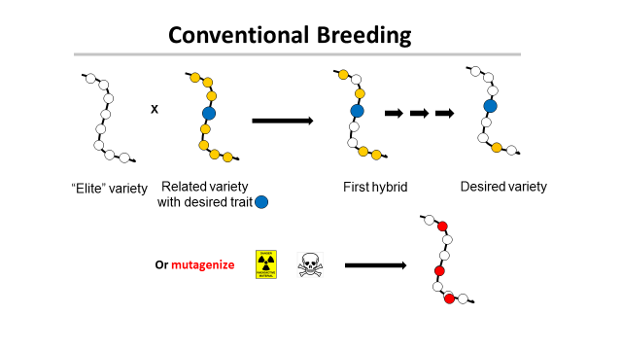
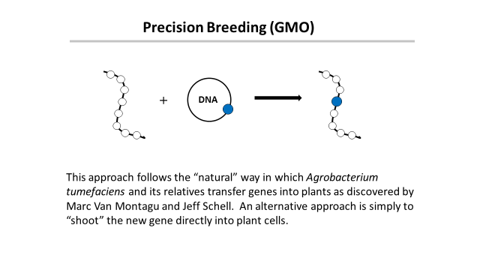
‘This is safe!’
← Greenpeace says →
‘This is dangerous!’

Slide 11
Traditional versus precision methods
I want to move a GPS system from my old car into my new one
Should I disassemble two cars, mix up the parts and then “select” for the one with the GPS, ignoring what else it might have picked up?
Or should I take the GPS from one car and move it to the other?

Slide 12
Traditional versus precision methods
If I take a GPS from an airplane
will the new car fly?

Slide 13
Genetic Modification refers to a method
But what is important is the
PRODUCT
not the
METHOD
This is just as true for traditional breeding

Slide 14
Food in Developing Countries
Africa, S. America, Asia need better crops with higher yields.
They need the products of precision breeding
Europe doesn’t
So why doesn’t Europe endorse this?
Could it be politics, or money or both?

Slide 15
The Real Problem
Europeans did not want US companies to control their food
How can that be prevented?
Ban Monsanto and the other big US agribusinesses
Not so fast - the farmers buy their seeds from them

Slide 16
The Green Parties Solution
Assert that precision breeding might be dangerous!
The politicians and the green parties will protect
you from this risk by banning GMOs
Best of all
This has no economic consequence for Europe !

Slide 17
The Precautionary Principle
If innovation might cause harm and there is no proof that it is safe
Wait until scientific evidence is available
But how much evidence is enough?
Insulin for diabetics, cheese, wine, bread
Vaccines for COVID-19

Slide 18
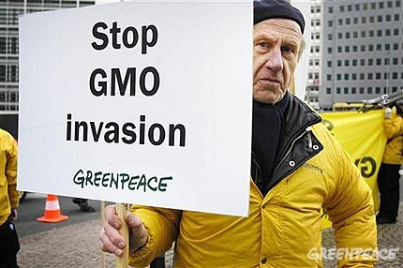
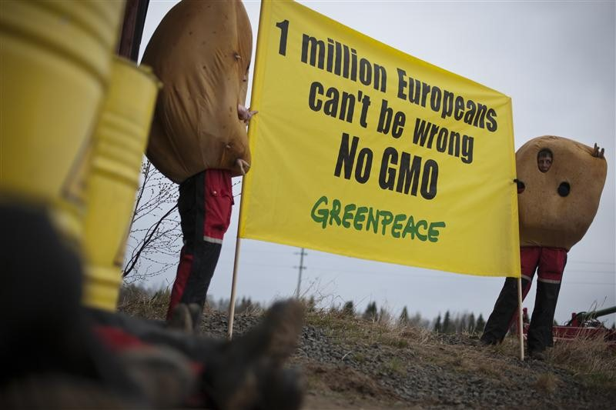
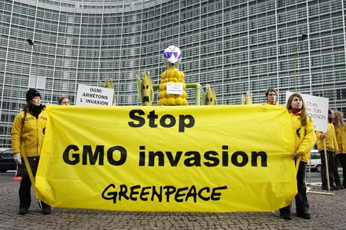
The tragic consequences
Not content with blocking precision agriculture in Europe many politicians and NGOs like “Greenpeace” and “Friends of the Earth” have been sending “missionaries” to the developing countries
Is Europe once again trying to instill their values on Africa?

Slide 19
A case study
Vitamin A-deficiency
Global population mortality (in millions)
Vitamin A-deficiency | 1.9-2.7
HIV/Aids | 1.7
Tuberculosis | 1.4
Malaria | 0.75
*Courtesy of Ingo Potrykus
Notes:
Golden Rice and Beyond – challenges of a humanitarian GMO project.

Slide 20
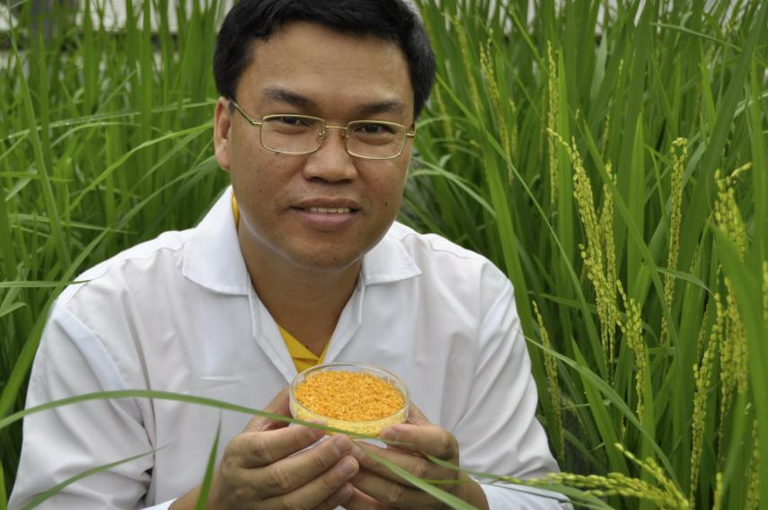
Golden Rice
A new source of Vitamin A
Suggested by Peter Jennings in 1984
Brought to fruition by
Ingo Potrykus, ETH Zurich
Peter Beyer, U. Freiburg
Tony Alfonso
Courtesy of Ingo Potrykus

Slide 21
Golden Rice
Became a reality in February, 1999.
Could have begun the improvements necessary for commercial production in the field within 2-5 years
But it’s a ‘GMO’ and only now is it about to be available
Multiple years of delay due to regulation and opposition.
Courtesy of Ingo Potrykus
Notes:
Golden Rice and Beyond – challenges of a humanitarian GMO project.

Slide 22
Science Fiction
Greenpeace blocks development
And then claims
It has taken so long it can’t possibly work

Slide 23
Since 2005 millions of children have died or suffered because of Vitamin A deficiency
How many must die before we consider this a “crime against humanity”?

Slide 24
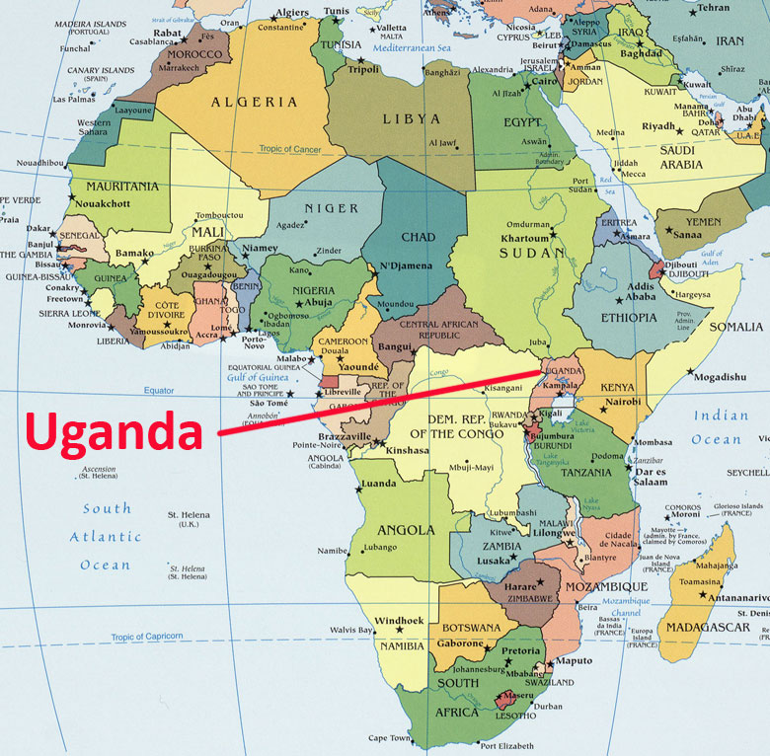
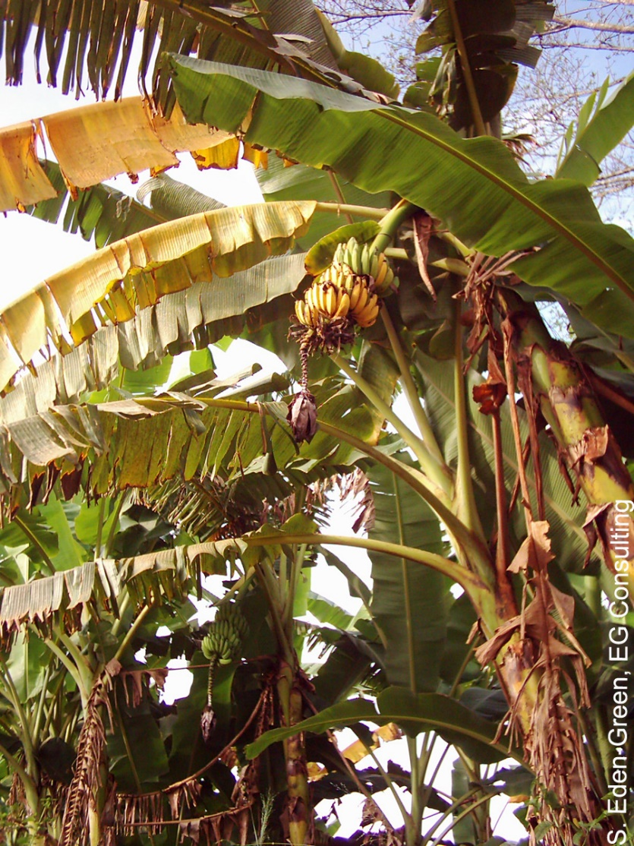
The Banana Problem
Xanthomonas wilt
No natural varieties are resistant so no
traditional breeding solution
BUT
Sweet pepper is resistant to Xanthomonas campestris and two genes are known that mediate this resistance. Using precision techniques these genes have been transferred to banana and these modified bananas are now beginning field trials.

Slide 25
Casava suffering from brown streak disease
In 2020 scientists in Kenya and Uganda engineered a CBSV resistant variety that is now approved for commercial production – at least in Kenya!

Slide 27
Bangladesh: Bt eggplant
Slide courtesy of Arif Hossain/Cornell Alliance for Science

Slide 28
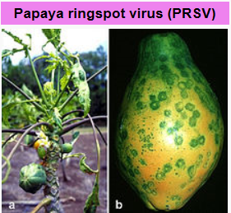
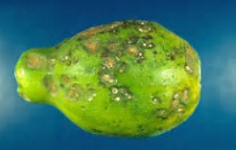
Hawaiian papayas
Almost a disaster

Slide 29
GMO Papaya saves the Hawaiian crop
In the 1990s, Hawaiian papaya trees were plagued by the ringspot virus which decimated half the crop in the state.
In 1998, Dennis Gonsalves from the University of Hawaii developed a transgenic fruit called Rainbow papaya, which is resistant to the virus.
Now 77 percent of the crop grown in Hawaii is genetically engineered and being eaten in the USA.
But in Thailand this solution is banned

Slide 30
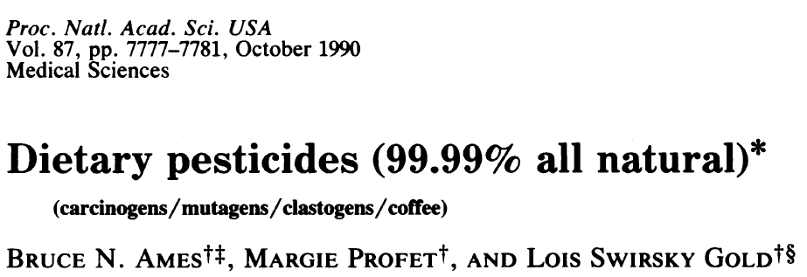
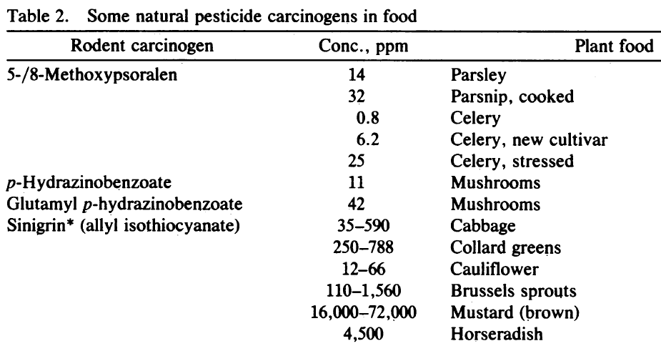
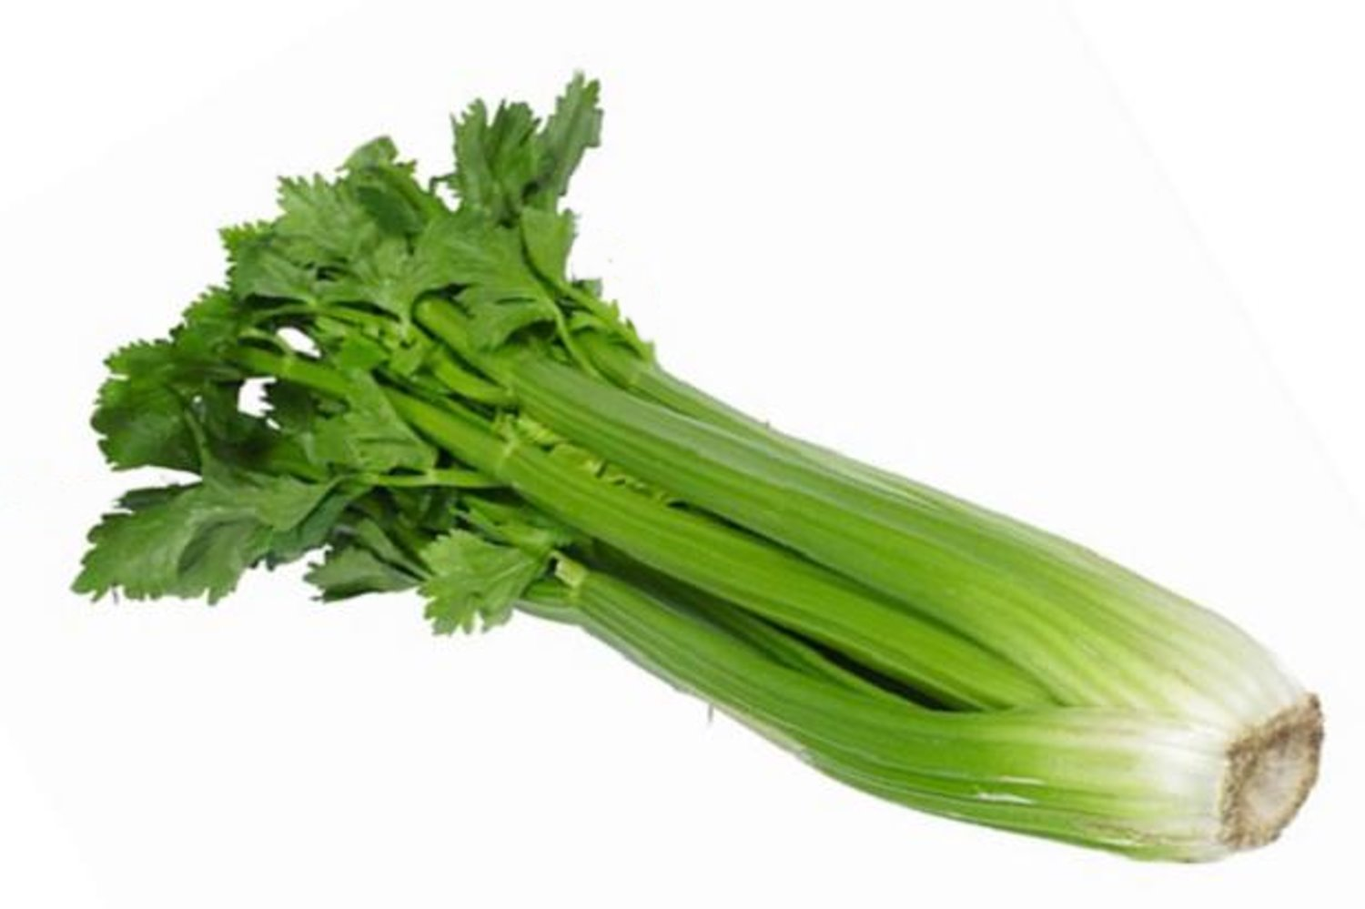
Many common vegetables have high levels of natural pesticides.
+ 11 more

Slide 31
The pesticide myth
Bt cotton in India
pesticide use Yield per hectare
2001 5,748 metric tons 308 kg
2013 222 metric tons 550 kg

Slide 32
Food choice is a luxury of the developed world
If you don’t want to eat foods derived by GM techniques, then don’t. It’s your choice
But don’t pretend such foods are dangerous
If anything
They are probably safer than traditional foods

Slide 33
Science Facts
For developed countries food is not a problem.
We must never forget the consequences of our actions for the developing countries
We need more science in politics
And less politics in science

Slide 34
Actions needed around the world
Politicians should listen to the scientists they fund
Stop supporting the idea that foods produced by precision breeding methods must be inherently more dangerous than traditional methods, when science shows they are not

Slide 35
Civil Society must play its role too
The major religious leaders should speak out
Groups such as the Rotary Clubs should speak out
Influential celebrities should speak out
The media should present science facts not science fiction

Slide 36
CONGREGATION FOR DIVINE WORSHIP AND THE DISCIPLINE OF THE SACRAMENTS
Prot. N. 320/17
Circular letter to Bishops on the bread and wine for the Eucharist
.
.
.
.
5. The same Congregation also decided that Eucharistic matter made with genetically modified organisms can be considered valid matter (cf. Letter to the Prefect of the Congregation for Divine Worship and the Discipline of the Sacraments, 9 December 2013, Prot. N. 89/78 – 44897).

Slide 37
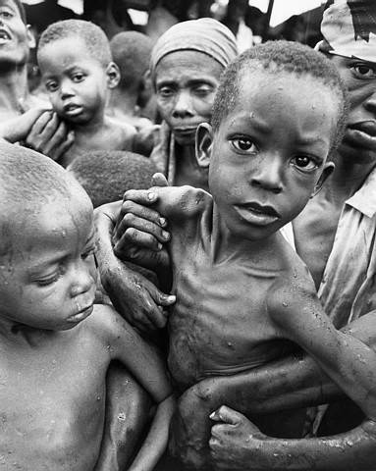
Have a heart
Non-GMO is a Western indulgence of the rich
It doesn’t work for the poor in Africa who ask
Will I eat today?
Not, What will I eat today?

Slide 38
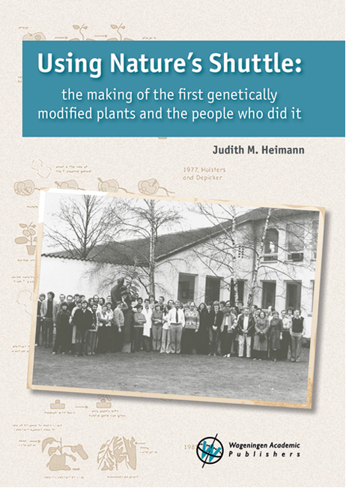
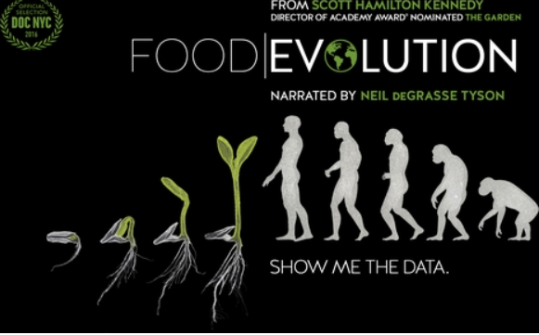
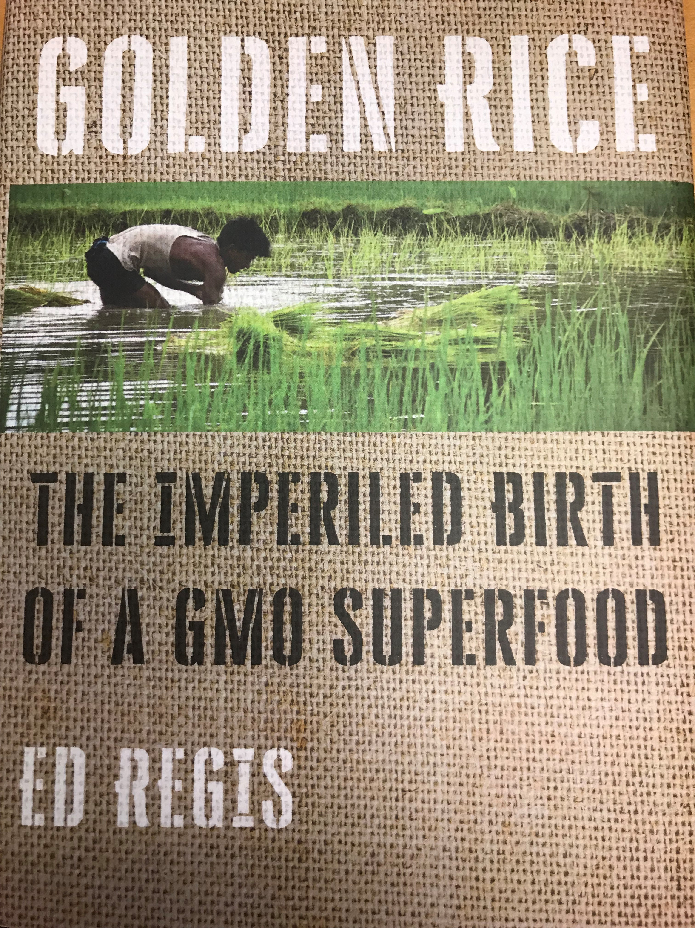
https://www.supportprecisionagriculture.org/

